Slide 1
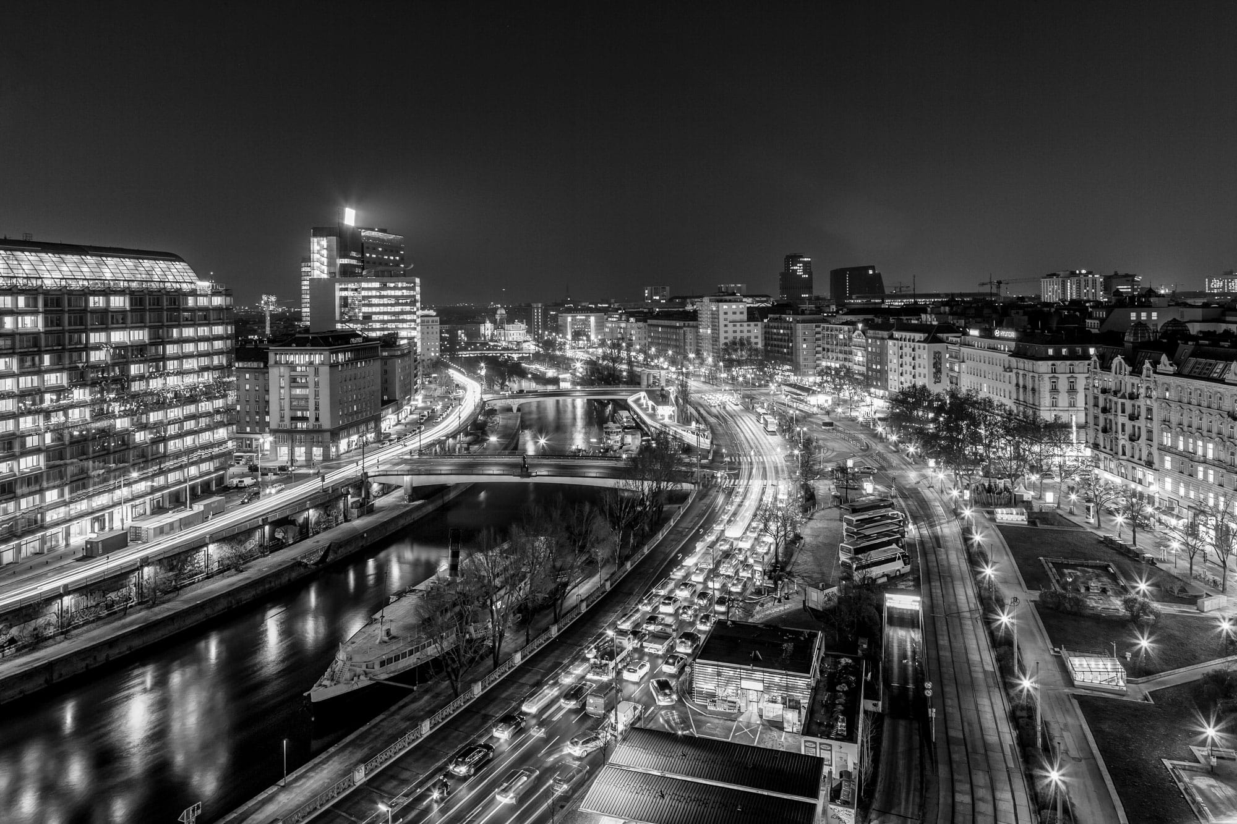
RIVER SOCIALIZER
Shareef Jasim

Slide 2
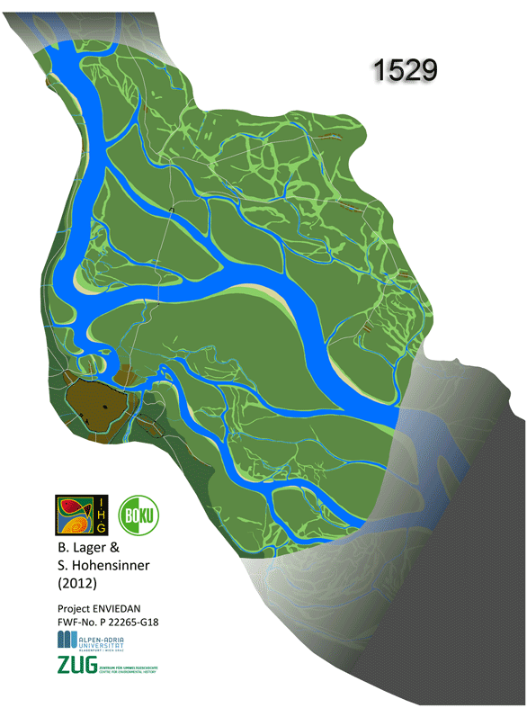
Historic Natural Wetlands

Slide 3
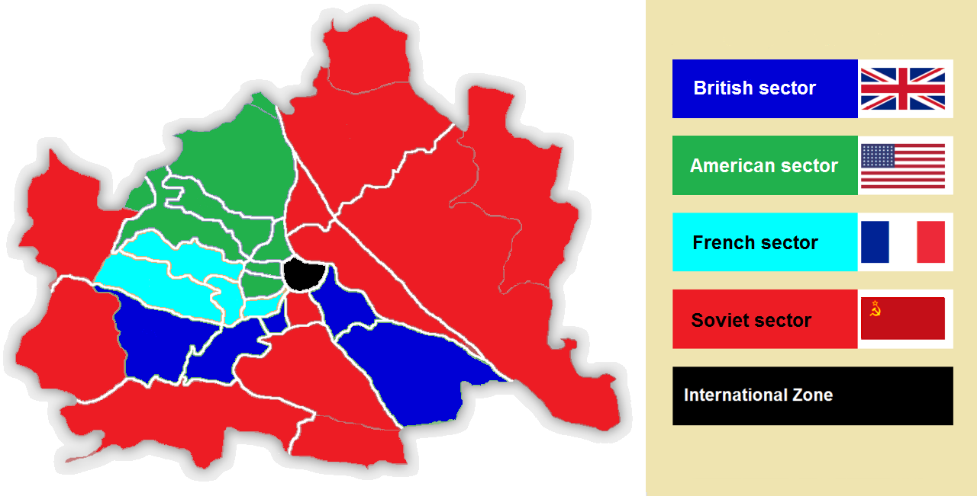
Occupied territories after WWII

Slide 4
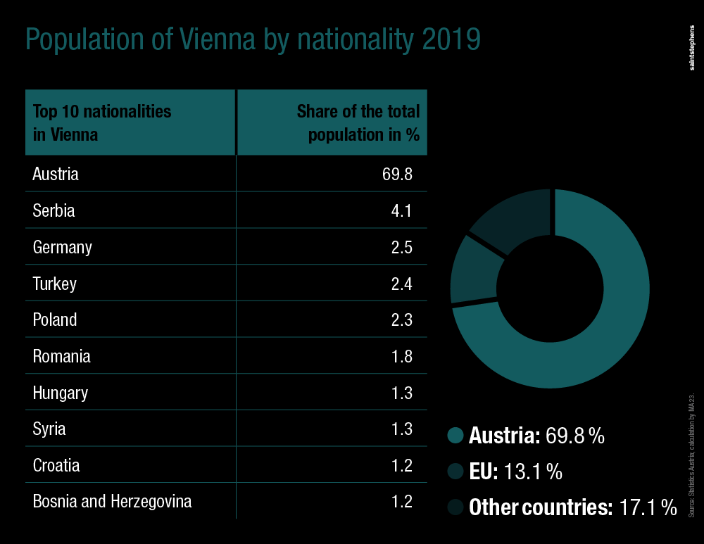
Diverse population 30% of Which are Non-Austrian

Slide 5
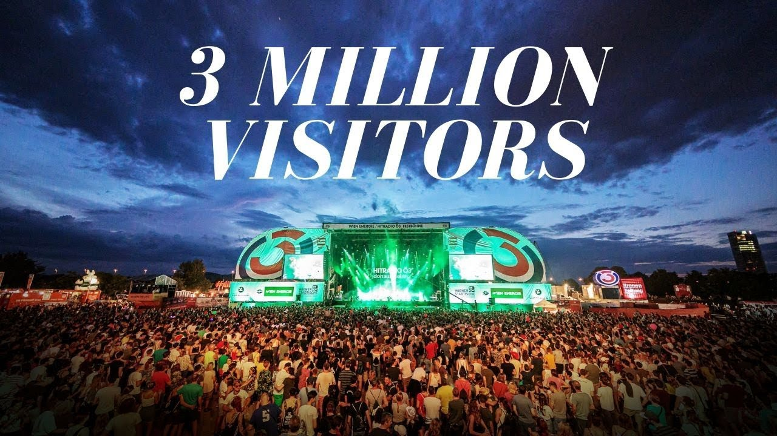
EUROPE`S LARGEST OPEN AIR FESTIVAL
“Donauinselfest”

Slide 6
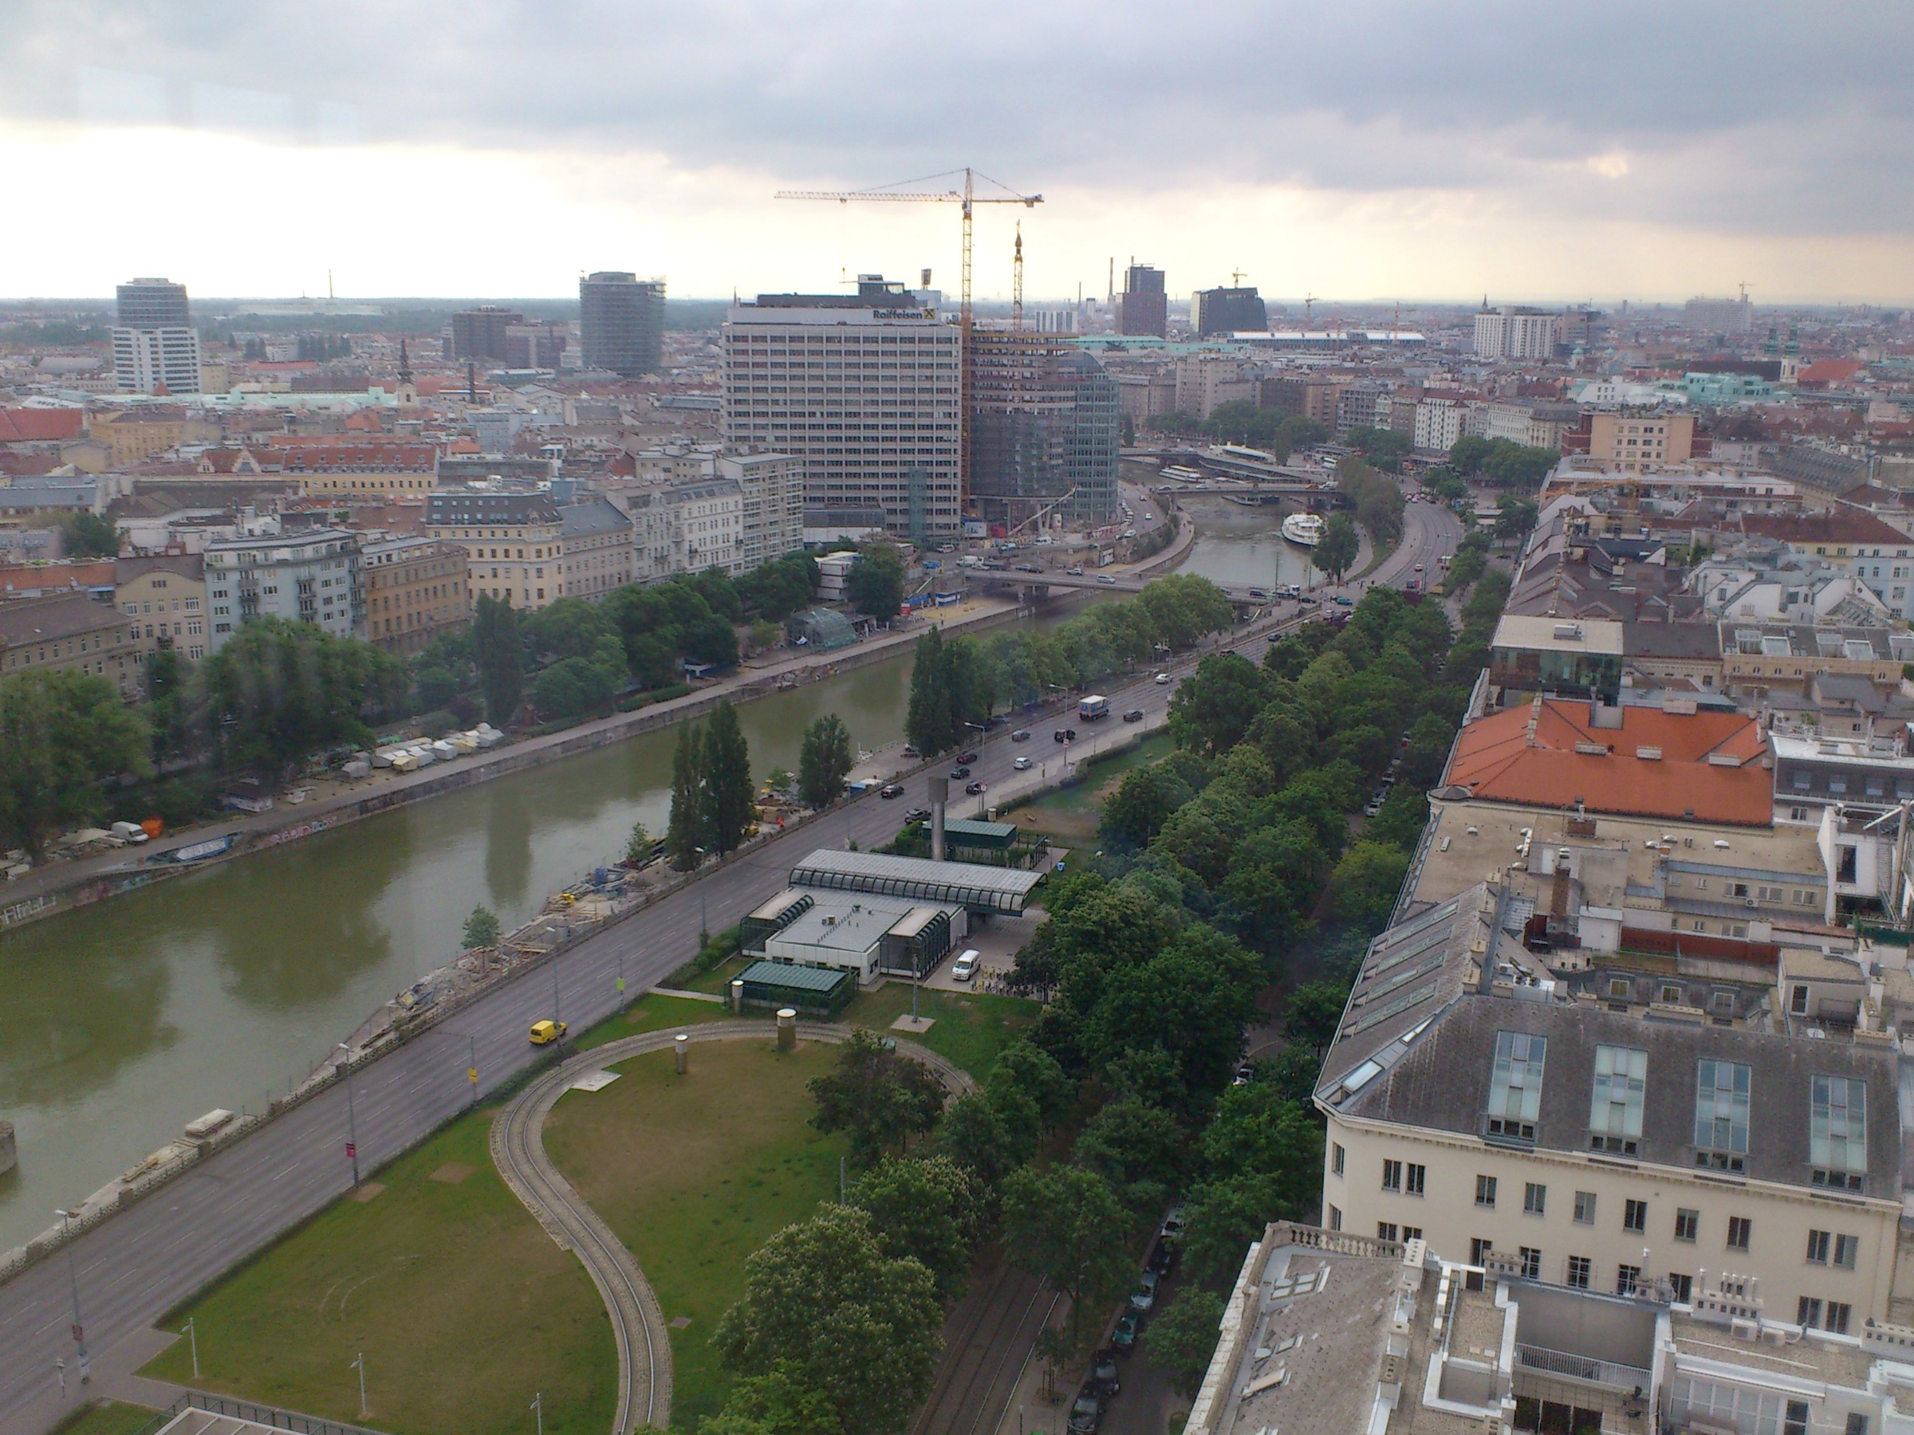
Many urban and architectural projects seeking to harness the cultural value of the site

Slide 7
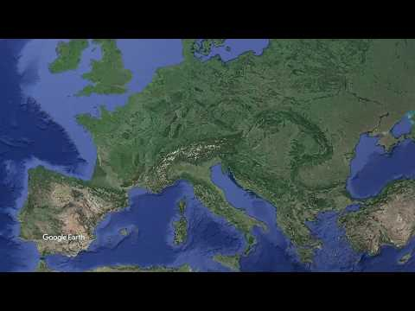
Site Tour

Slide 8
Design Inputs
Historically Natural site
Eco of conflict
Cultural Significance
High density

Slide 9
Ordering system
Socio-cultural Art facilities
Environmental Living machine using the wetlands/ TiO2 / Solar panels
Functional Commuter targeting / tourists targeting / locals
Economy Income to the site from ports / F&B /exhibitions and performances
Aesthetics Deconstructive style mimicking visualizing the historical clash and weaves the two sides

Slide 10
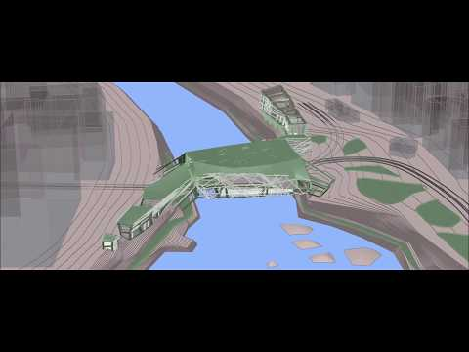
Concept development

Slide 11
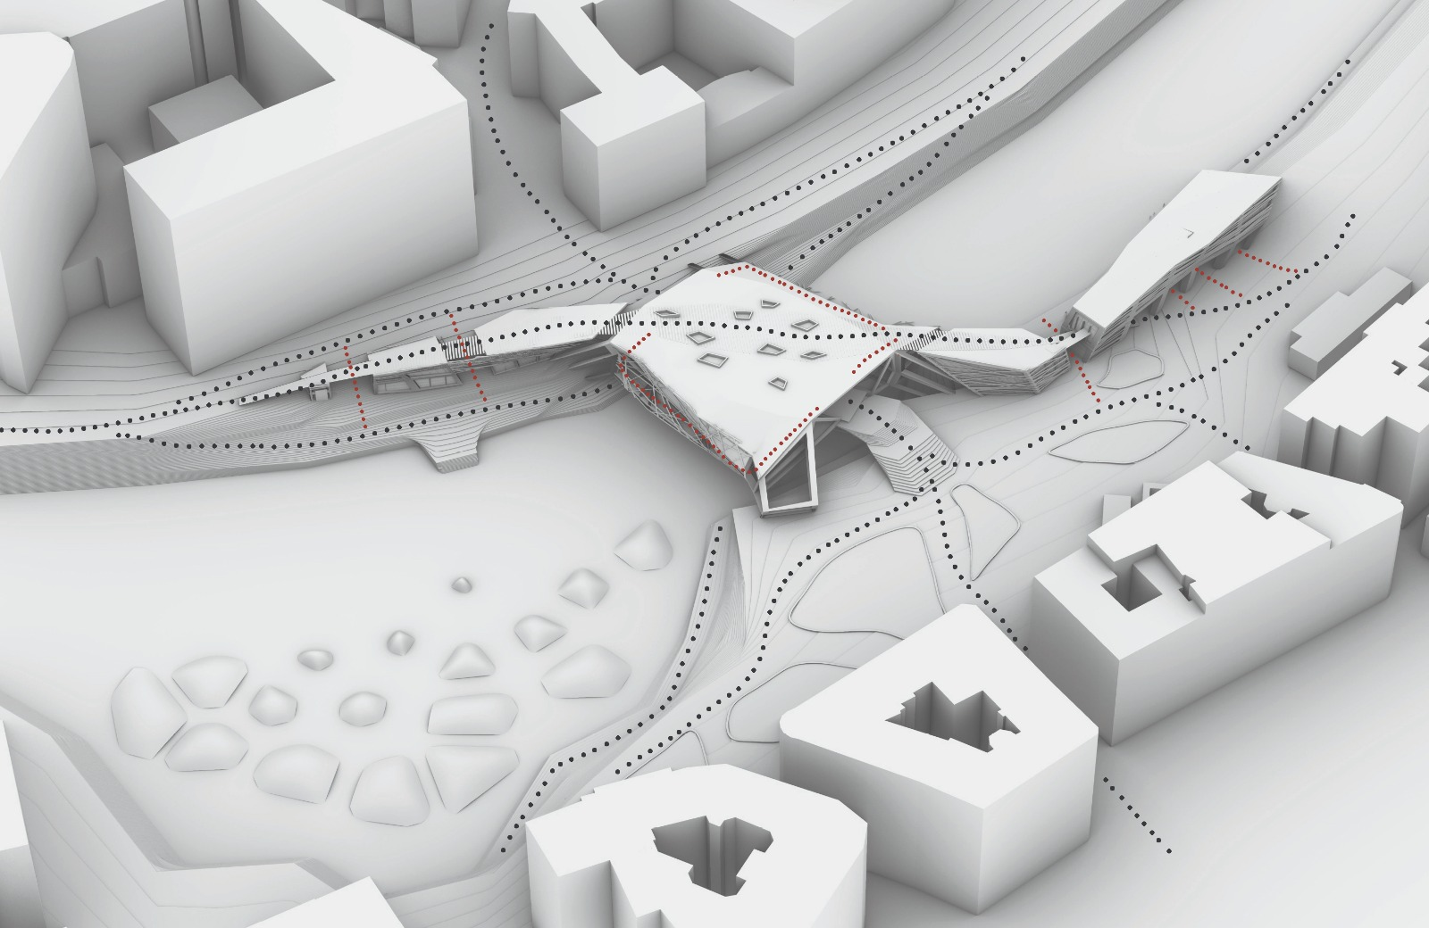

Slide 12
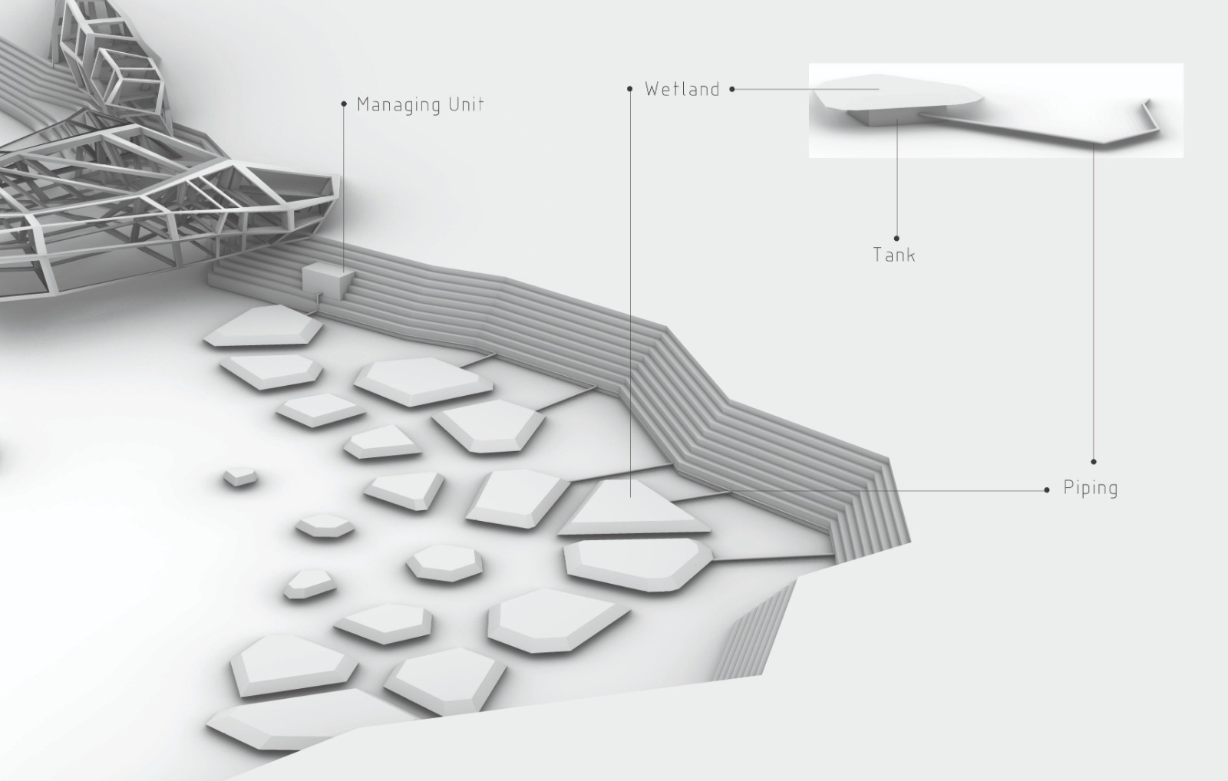

Slide 13
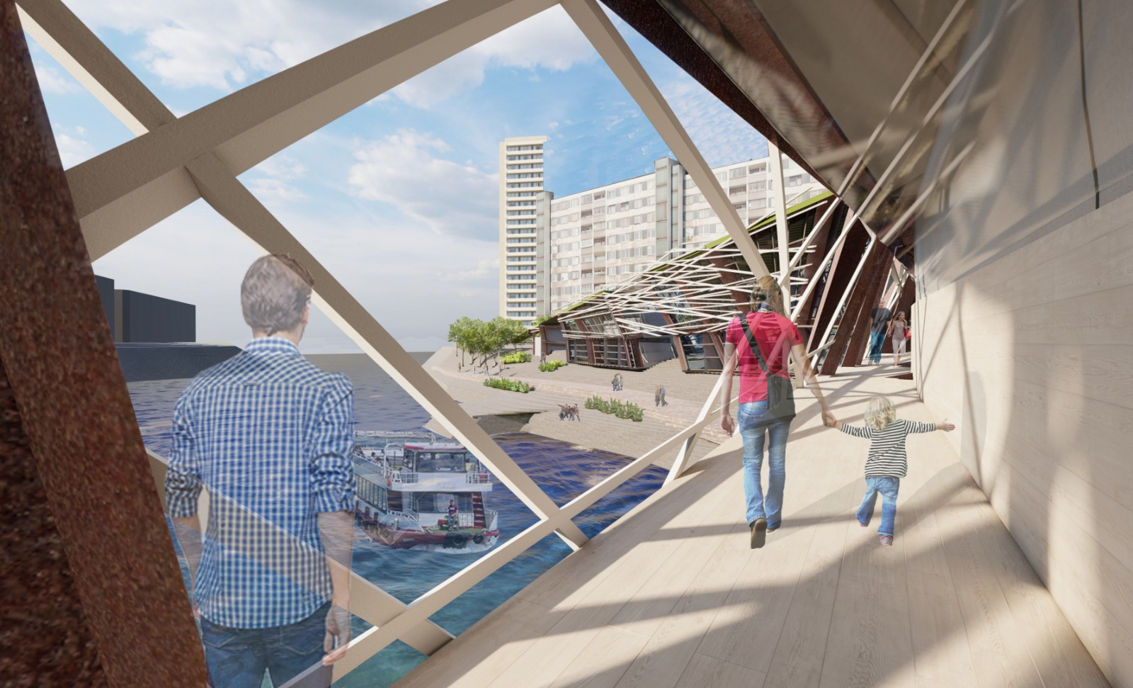

Slide 14
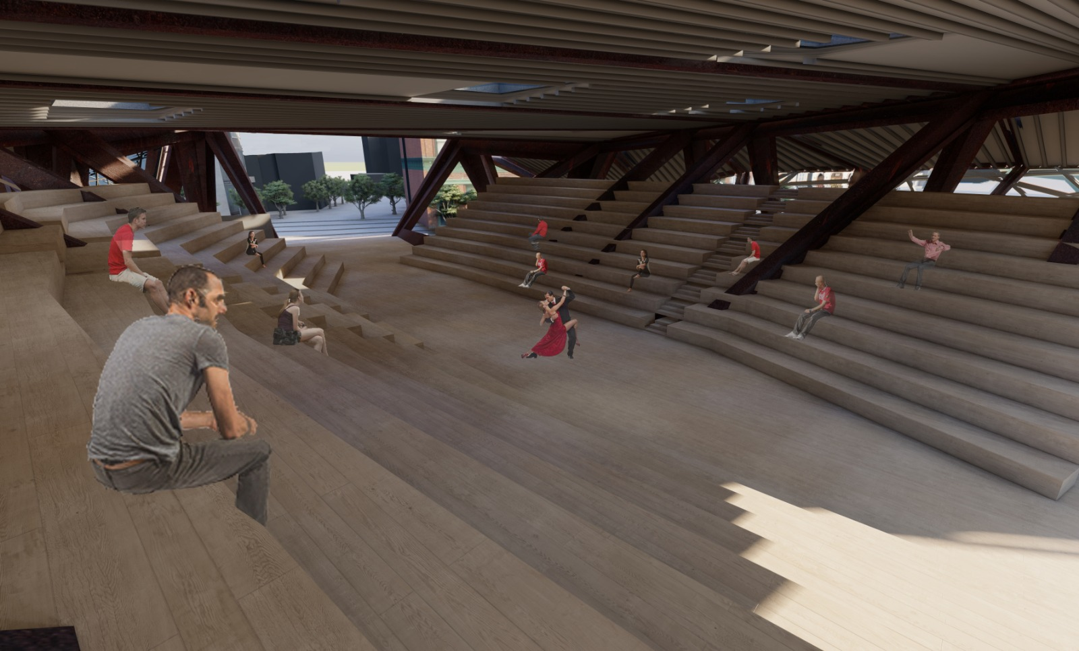

Slide 15
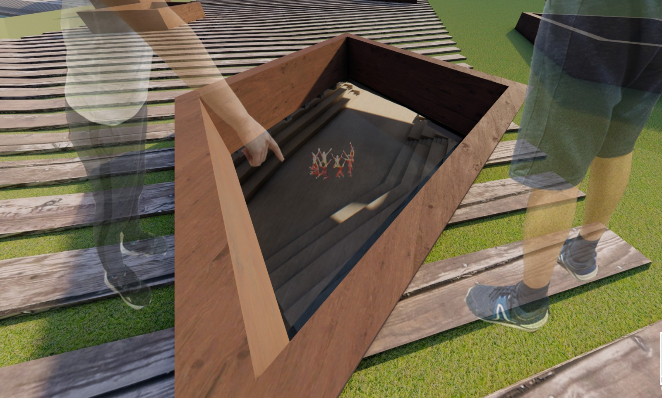

Slide 16
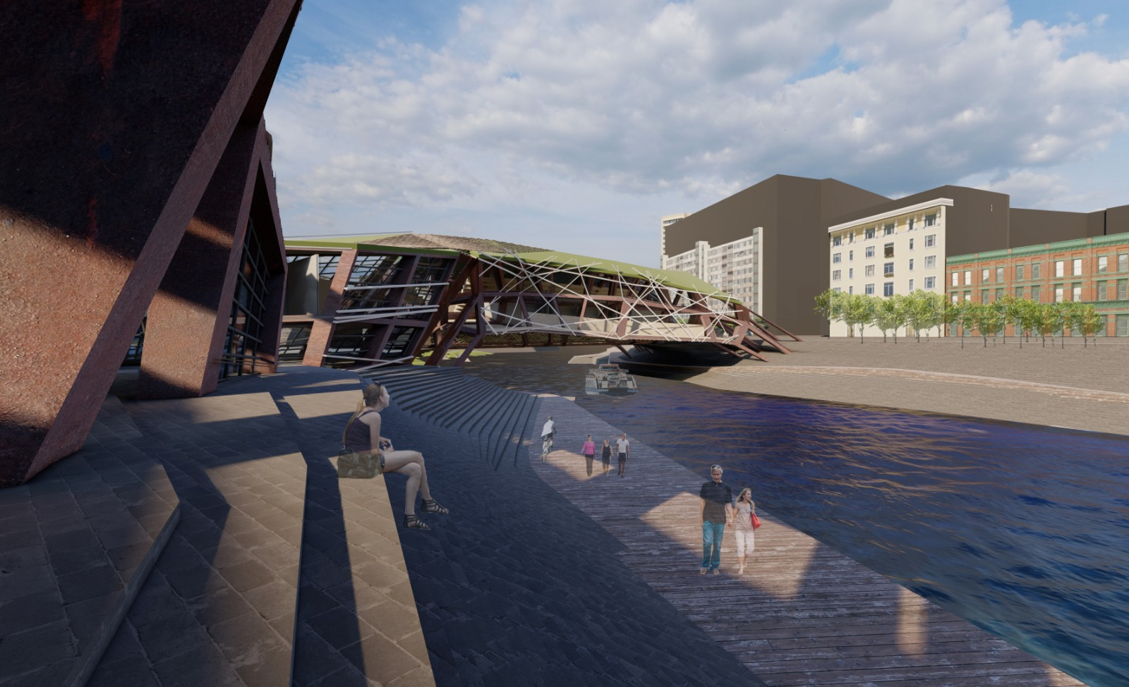

Slide 17
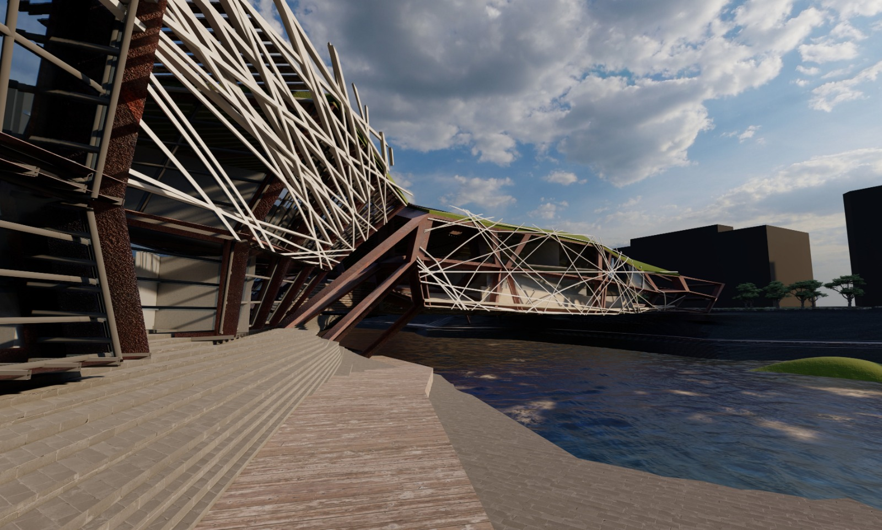

Slide 18
