Slide 1
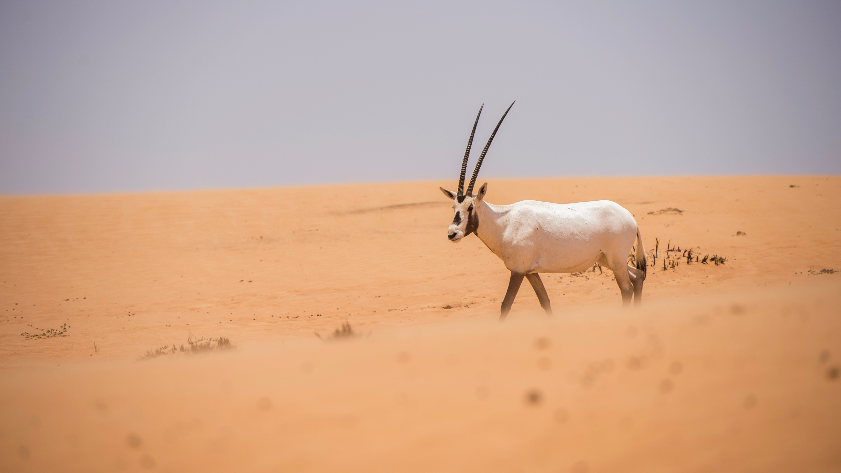
ARCH 402 Graduation Project MegaDune Ecolodges in AbuDhabi
Mustafa Enes Toru
Instructor: Mark Paul Frederickson

Slide 3
Masterplan
Concept
Diagrams
Sand turning into sandstone
Exterior Renders
Interior Renders

Slide 4
Arabian Oryx Protected Area
The Arabian Oryx Protected Area is home to the largest population of Arabian Oryx in the world. Spanning over 5,900 square kilometers, it is located in the southern region of the UAE, bordering Saudi Arabia and Oman.
The majority of the Arabian Oryx Protected Area consists of sand sheets and dunes ,with some mega dunes and gravel plains with dwarf shrub vegetation located throughout the area.
In addition to being home to the Arabian Oryx, the protected area supports 92 species of plants, birds, reptiles and mammals. The diversity of some animal groups in the protected area is significantly lower than would be expected of large mammals.

Slide 5
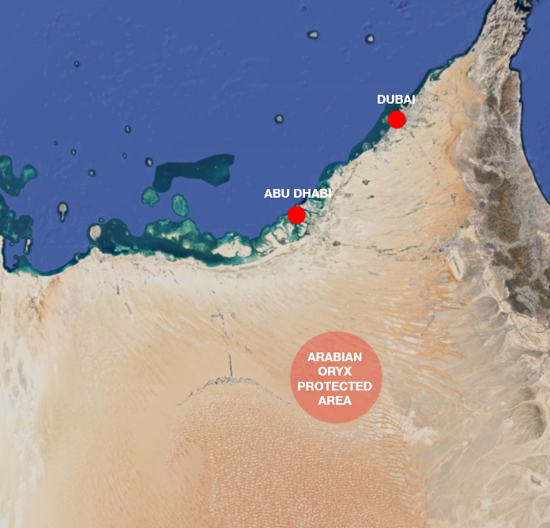

Slide 6
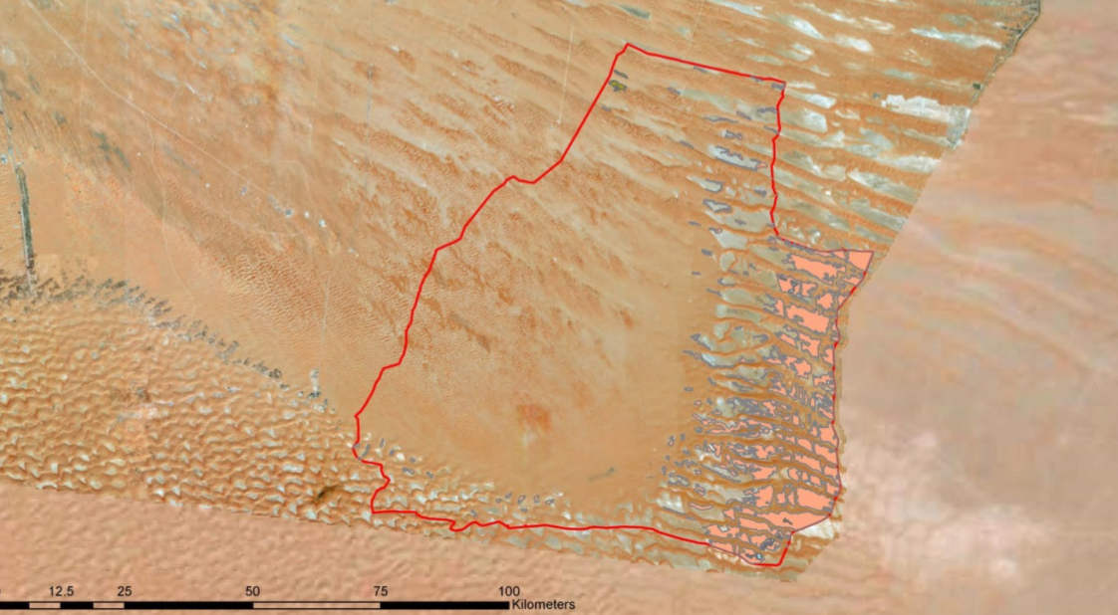
Arabian Oryx Protected Area

Slide 7
Accesibility Diagram
The main access will be provided by cable car, also service.
This also provides users to take a tour of that great environment.
Eventually because of those places it will be easier to take WATER from underground.

Slide 8
Master Plan Strategy, from now to the future

Slide 9
Response To the Threat / Creating Oasis in the Valley

Slide 10
Masterplan

Slide 11
Function Diagram

Slide 12
Articulation

Slide 13
Vertical Section

Slide 14
Horizontal Section

Slide 15
Bacillus Pasteurii

Slide 17
How it can be constructed?
Injection the Bacteria
The injection Piles which are filled with the bacteria helps creating any kind of forms.

Slide 18
Magic Glass Skylight

Slide 19
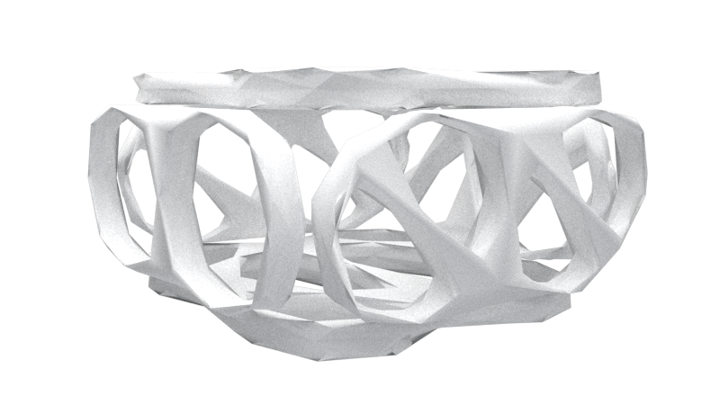
Structure of the Voronoi
In the voronoi structure, basically it works like the same strategy with column and beam but the fundamental difference is the shape. In my project, some lodges/modules will be worked each of its voronoi structure and interior will be added inside of it. And also that will help for ventilation and other stuffs as well

Slide 20
Ventilation Diagram of Voronoi

Slide 21
Masterplan

Slide 22
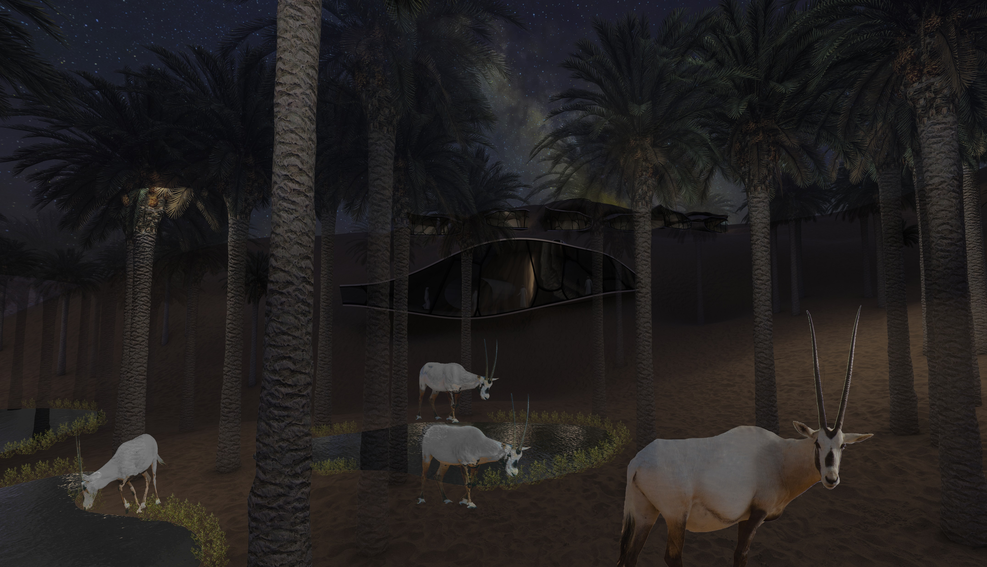

Slide 23
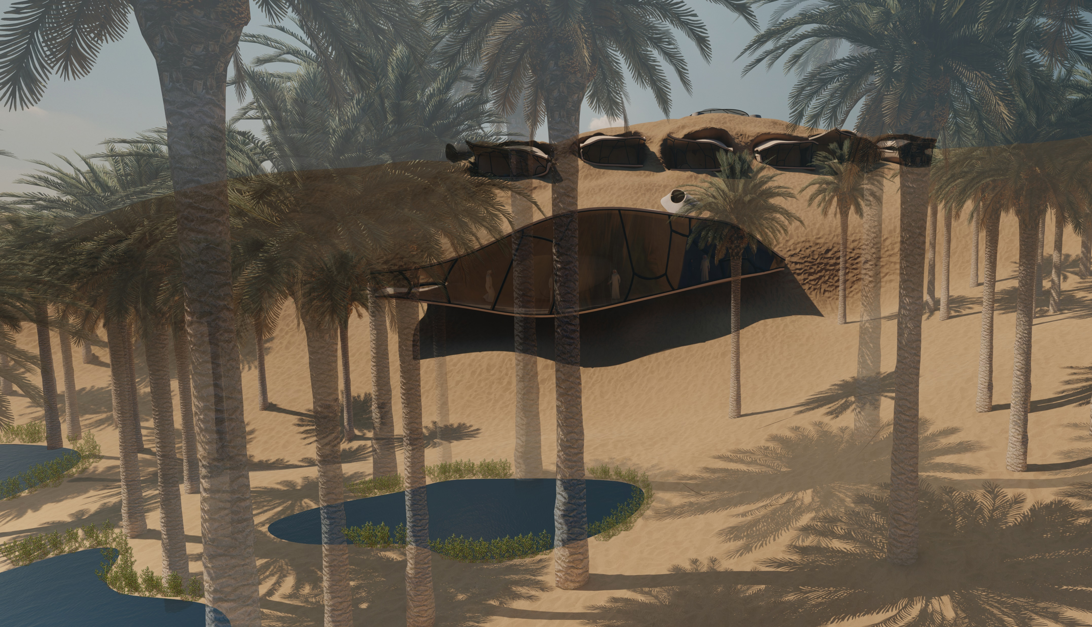

Slide 25
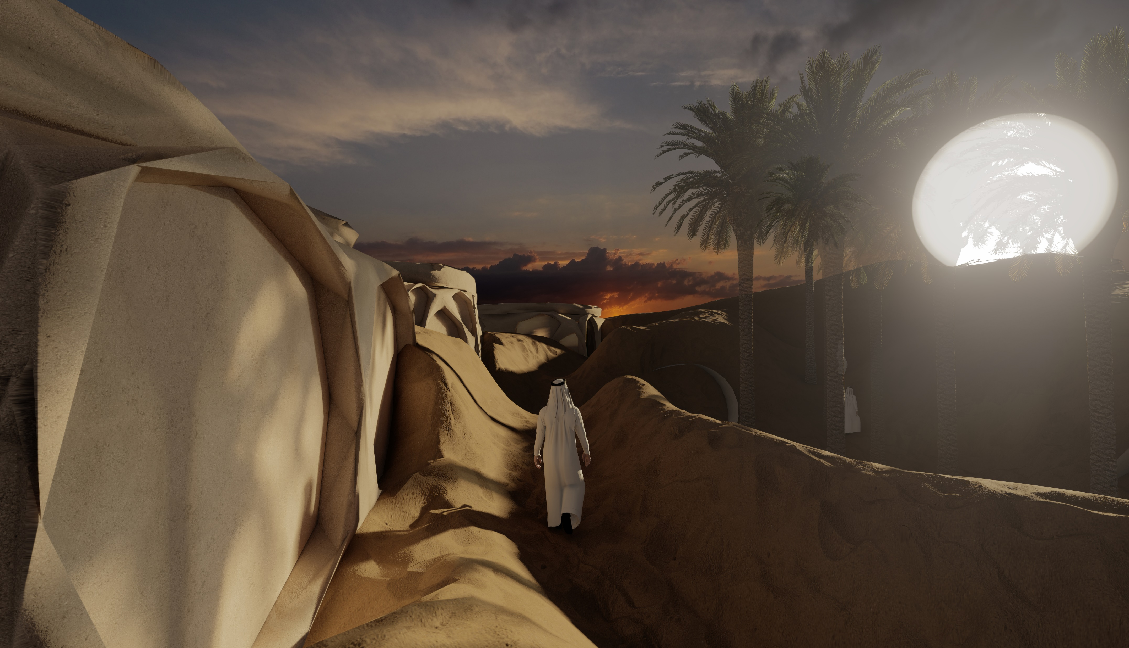

Slide 27
