Slide 2
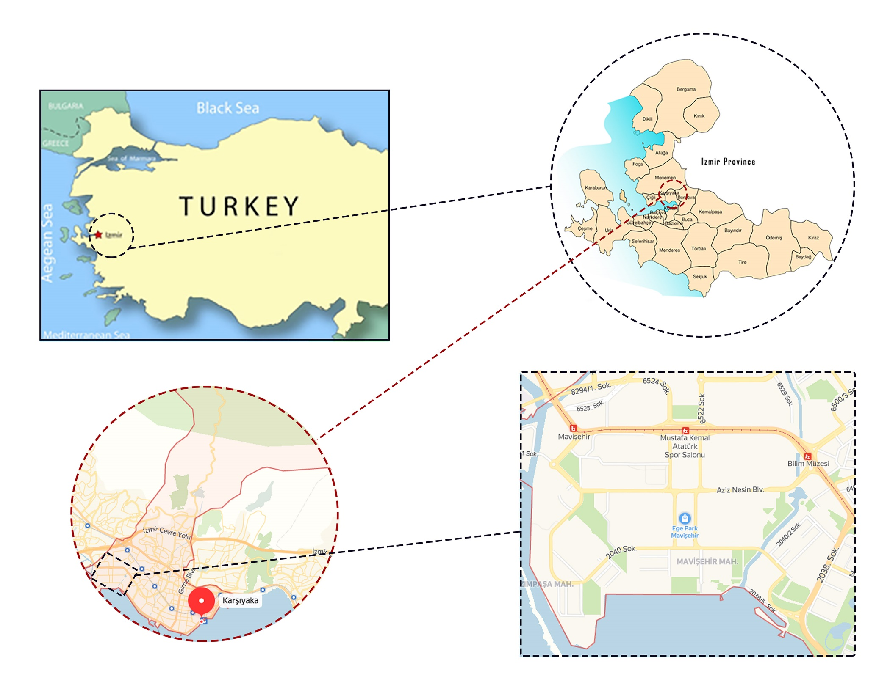
INTRODUCTION TO SITE
West side of Turkey
Adjacent to the pond and
the Aegean sea

Slide 3
VIEWPOINTS

Slide 4
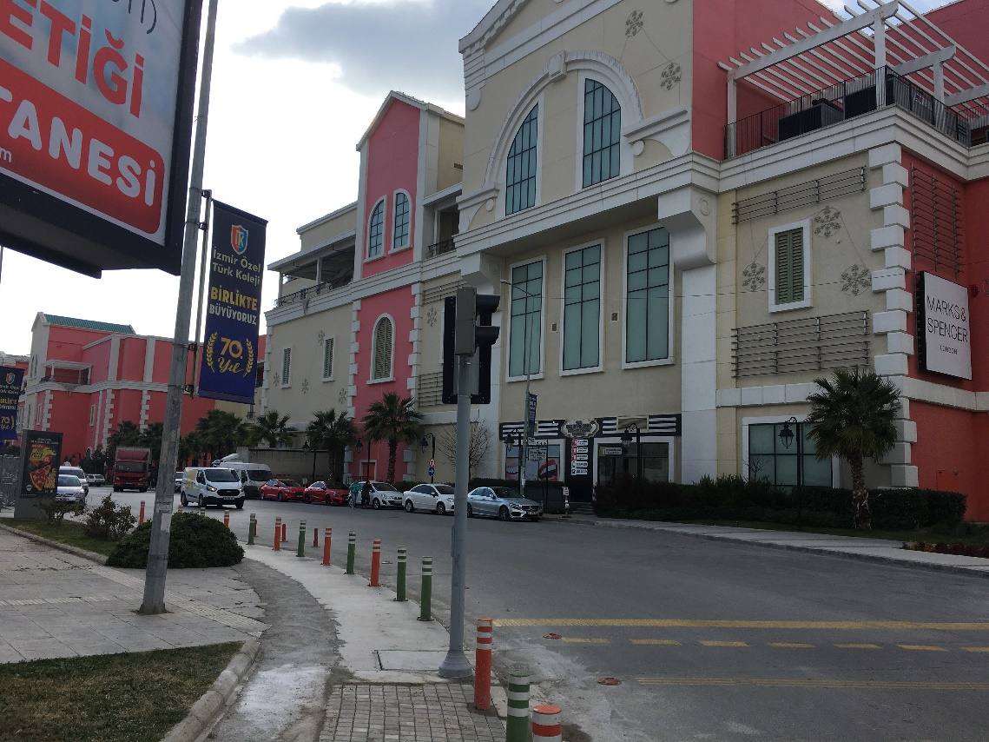
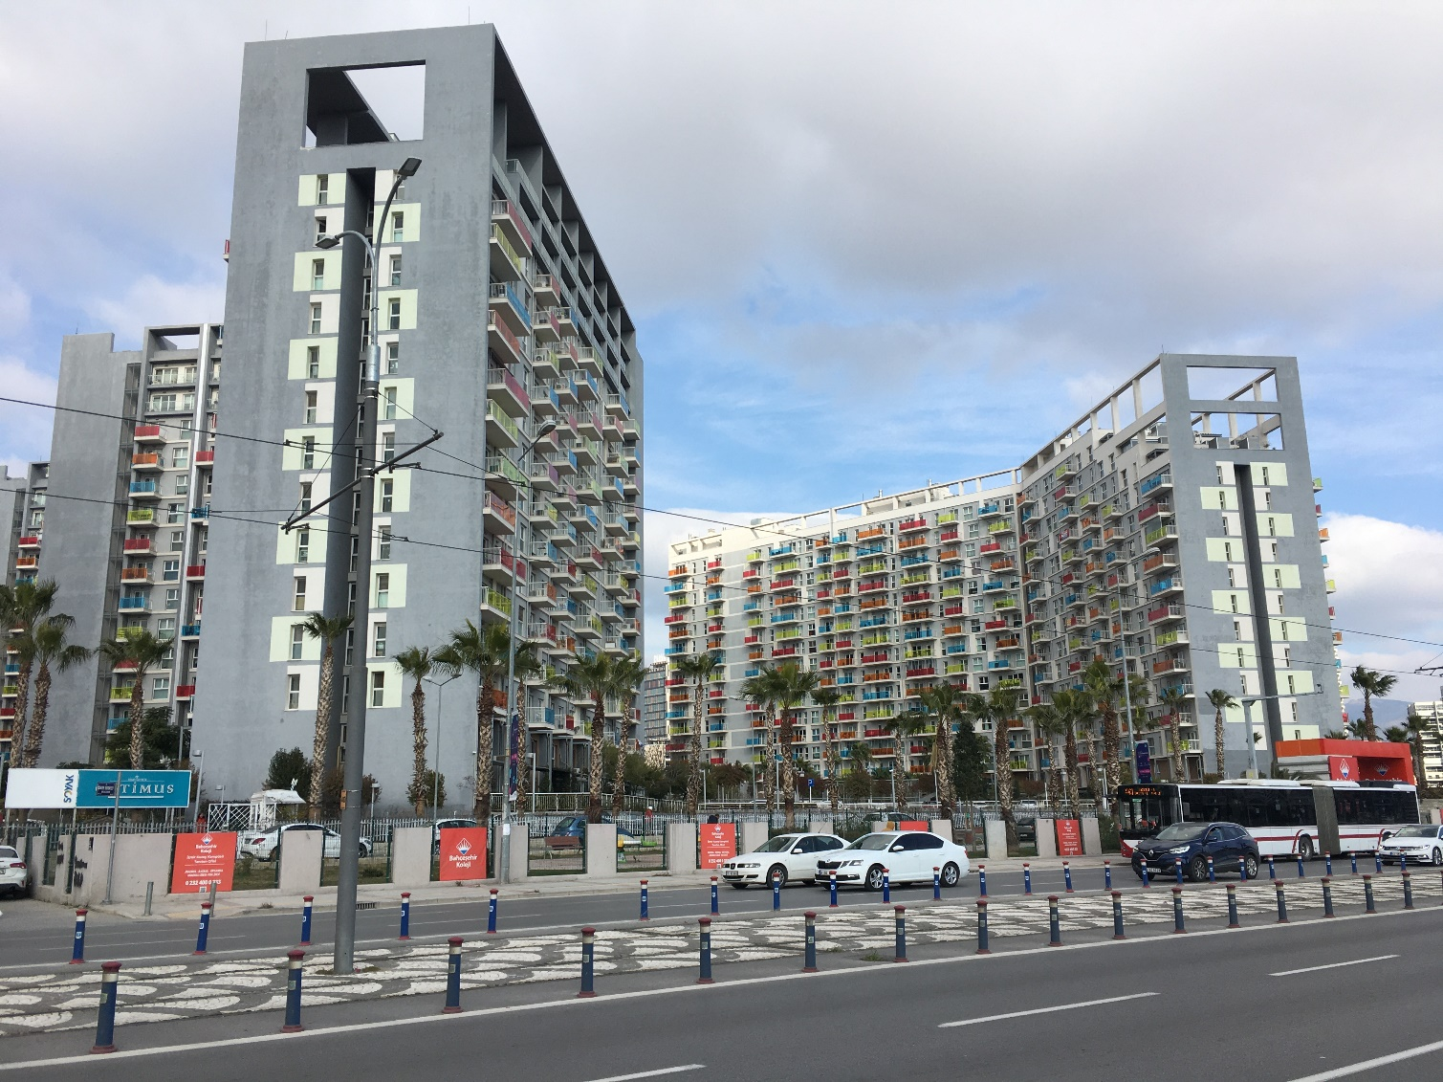
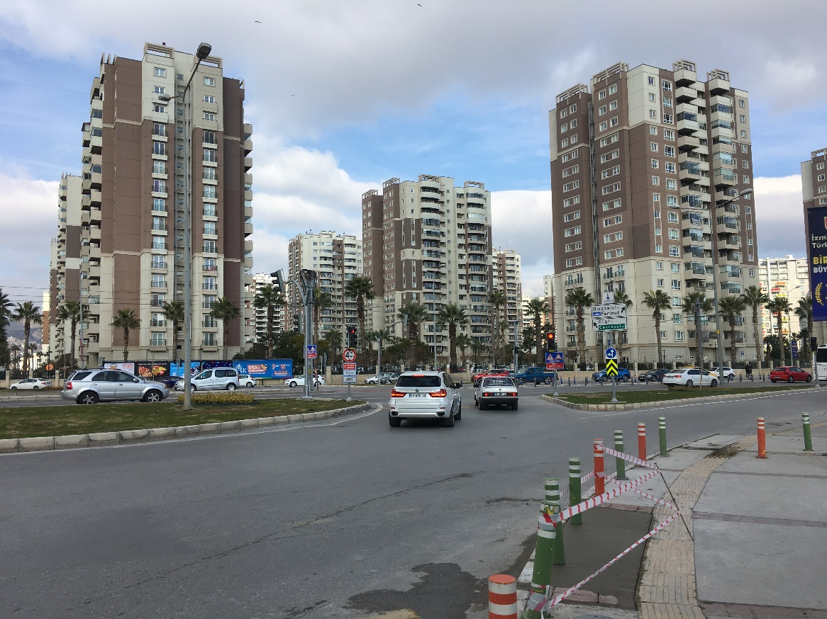
1
3
2

Slide 5
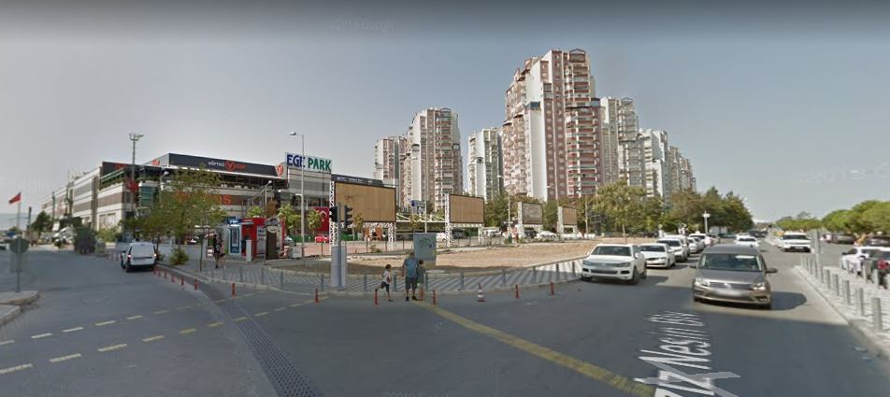
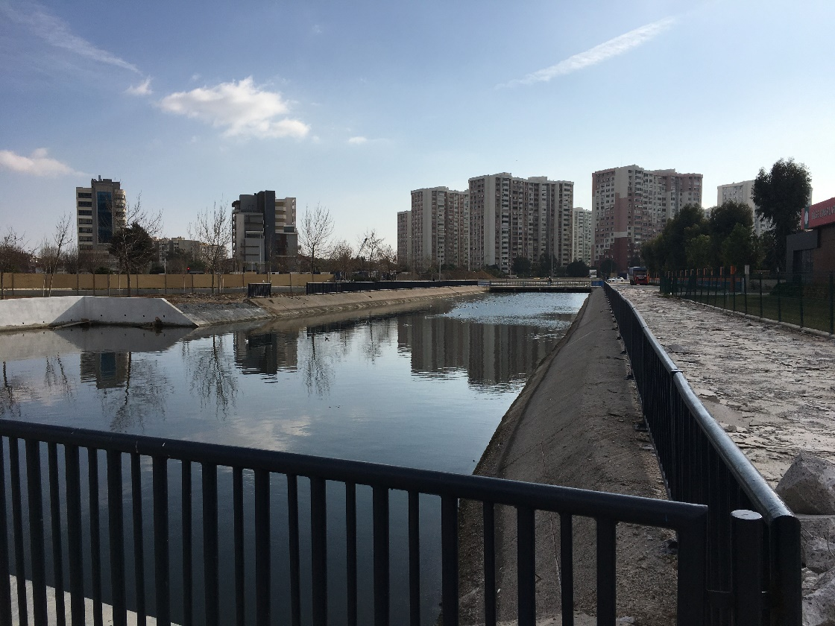
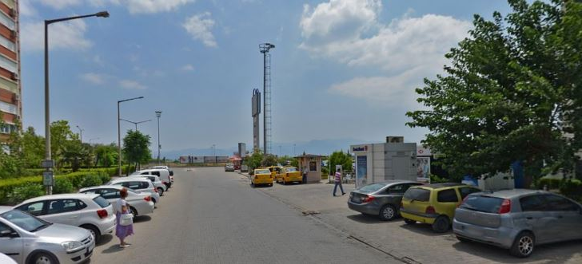
4
5
6

Slide 6
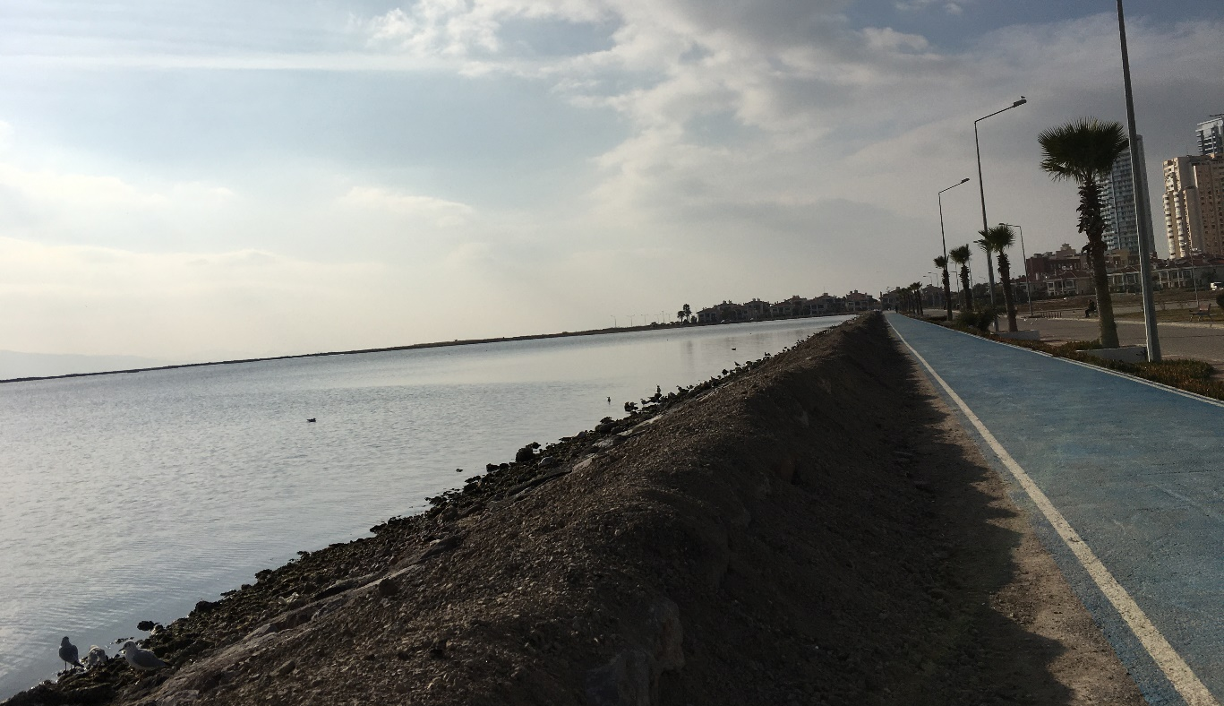
7
9
8

Slide 7
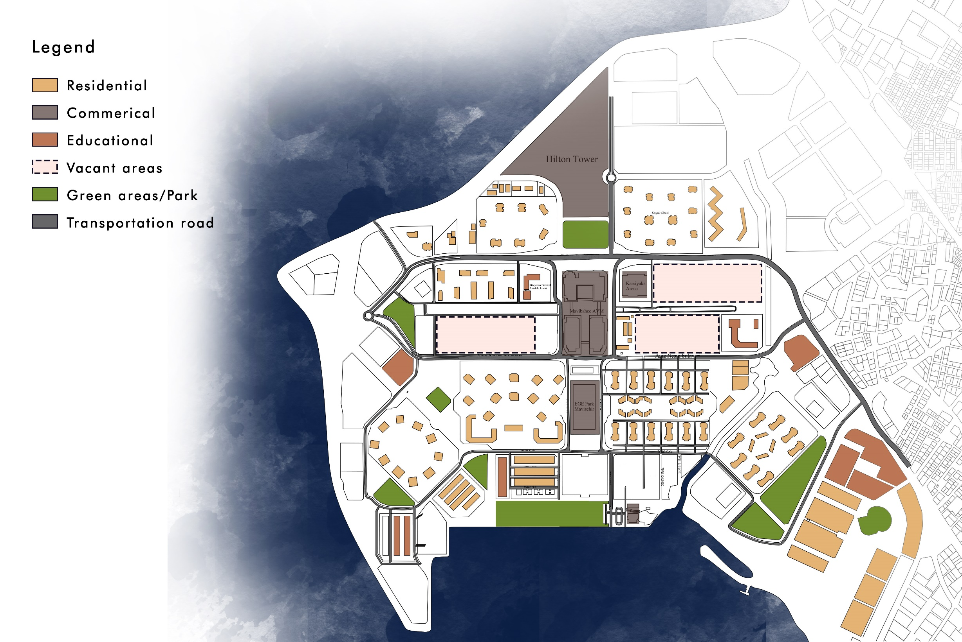
EXISTING
FUNCTIONS

Slide 8
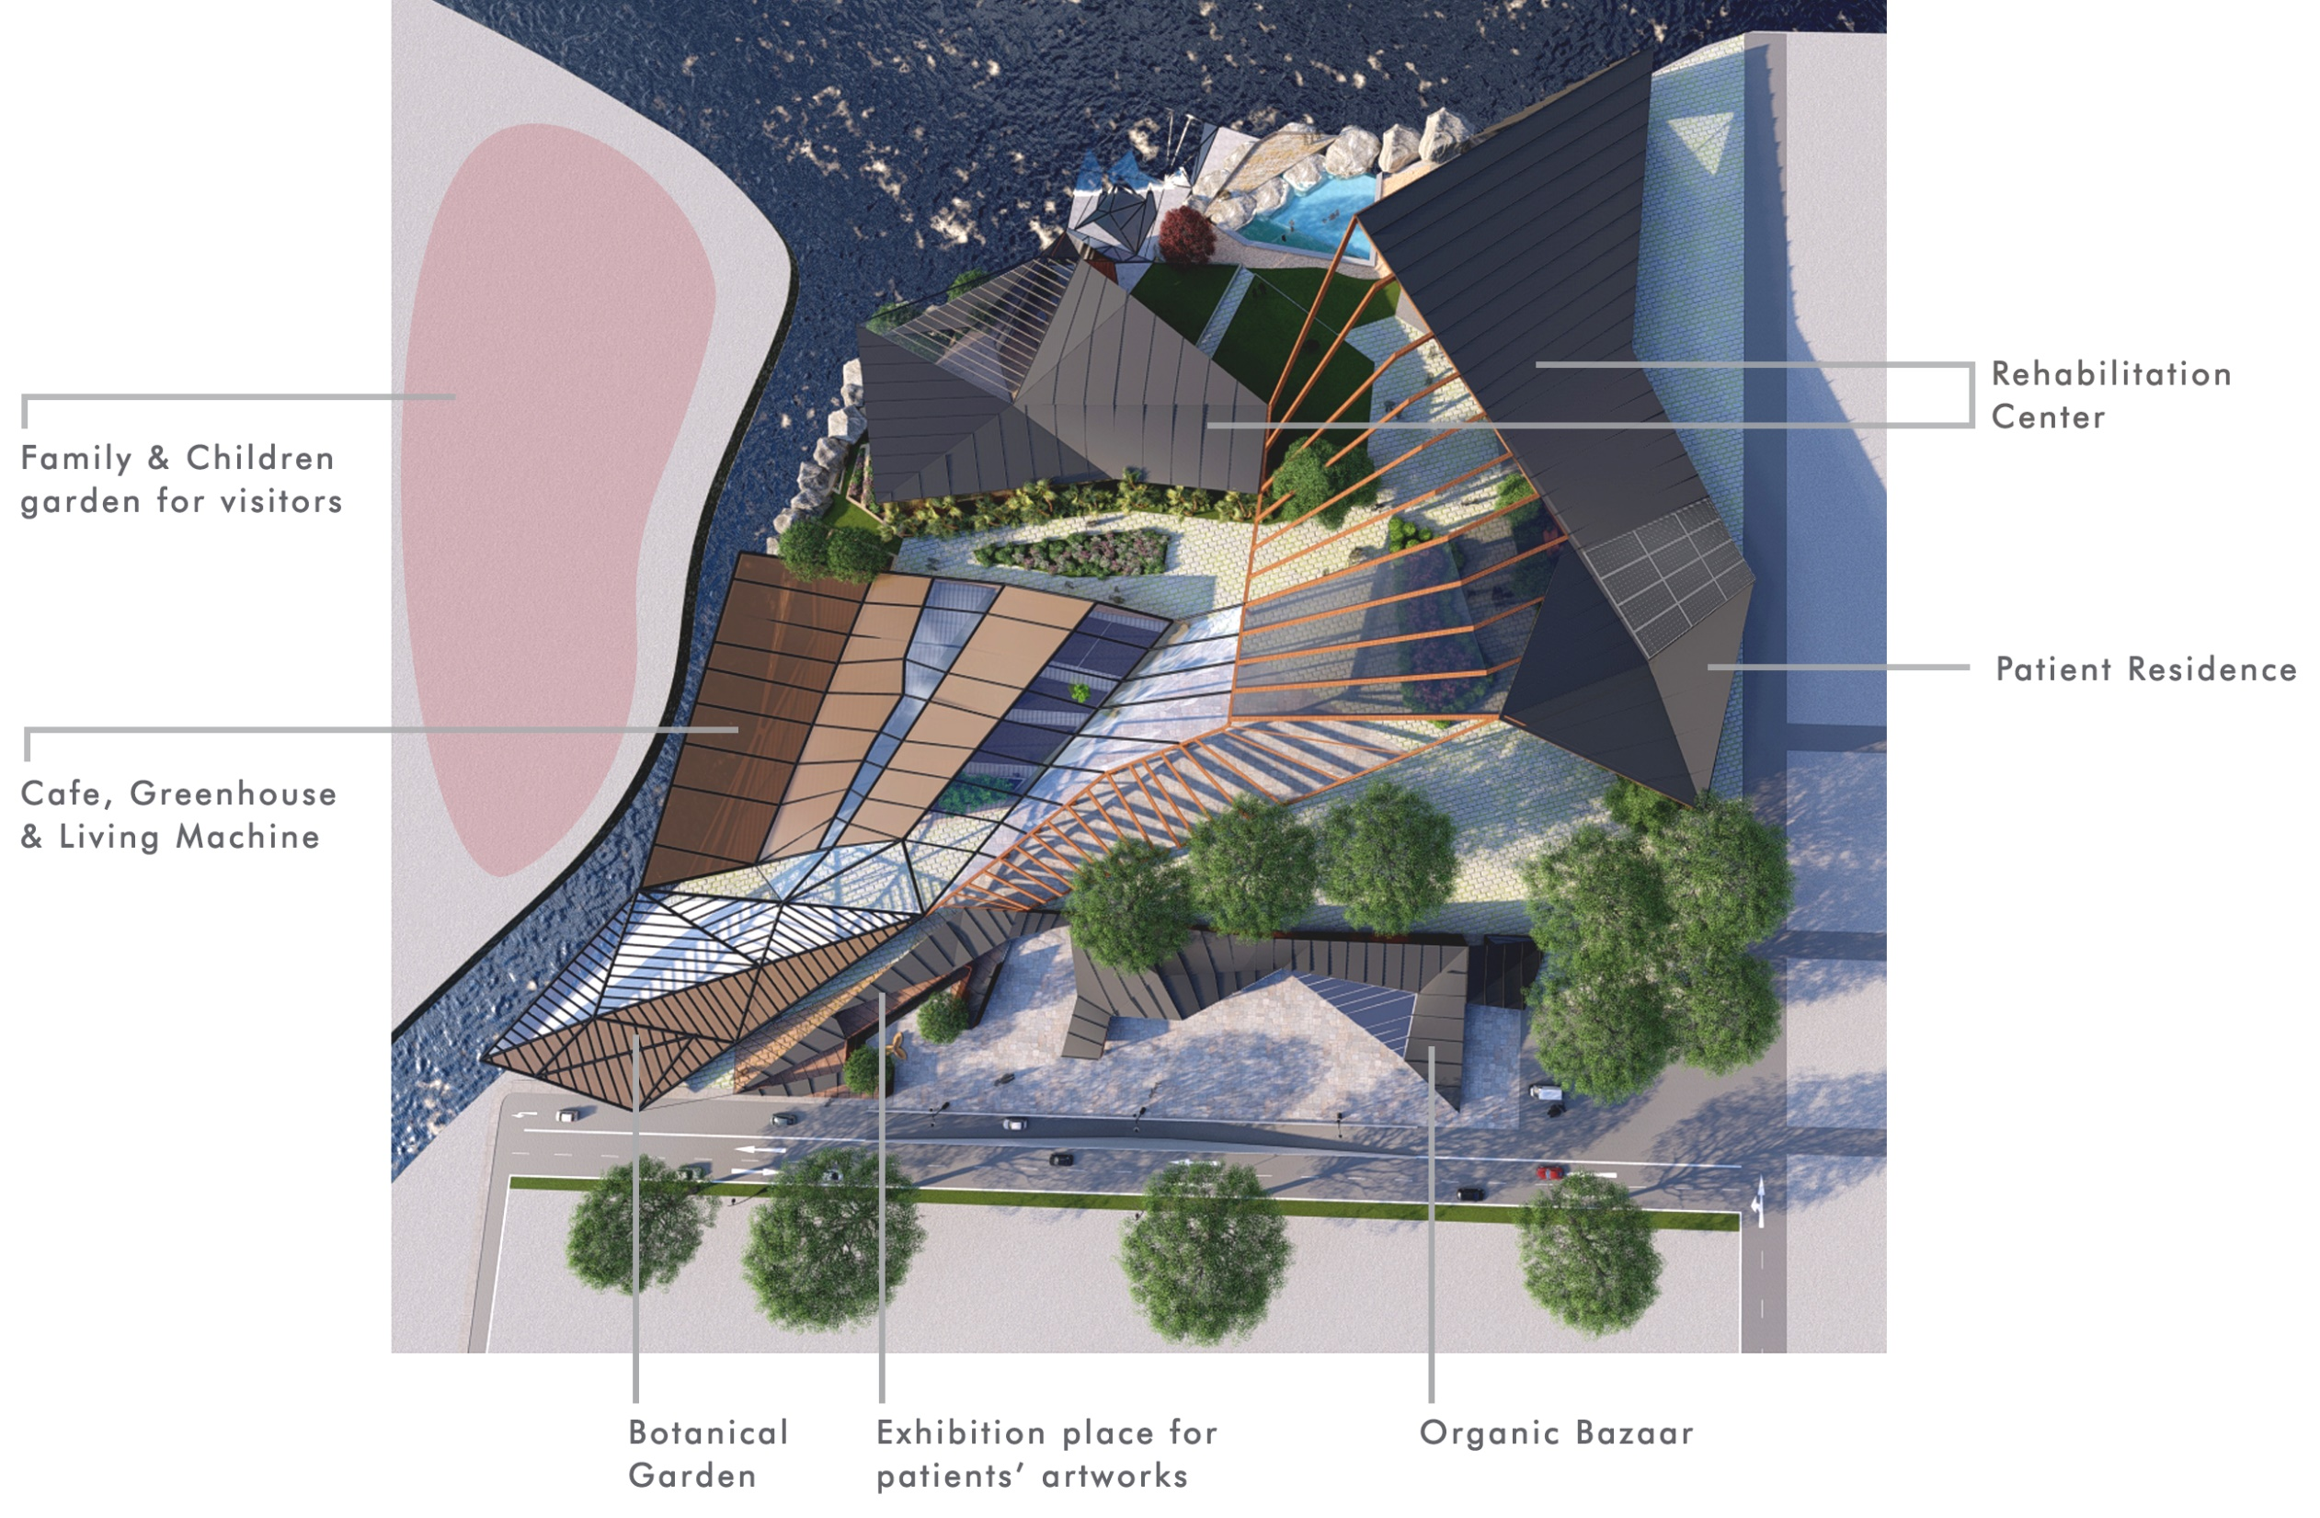
SITE PLAN

Slide 9
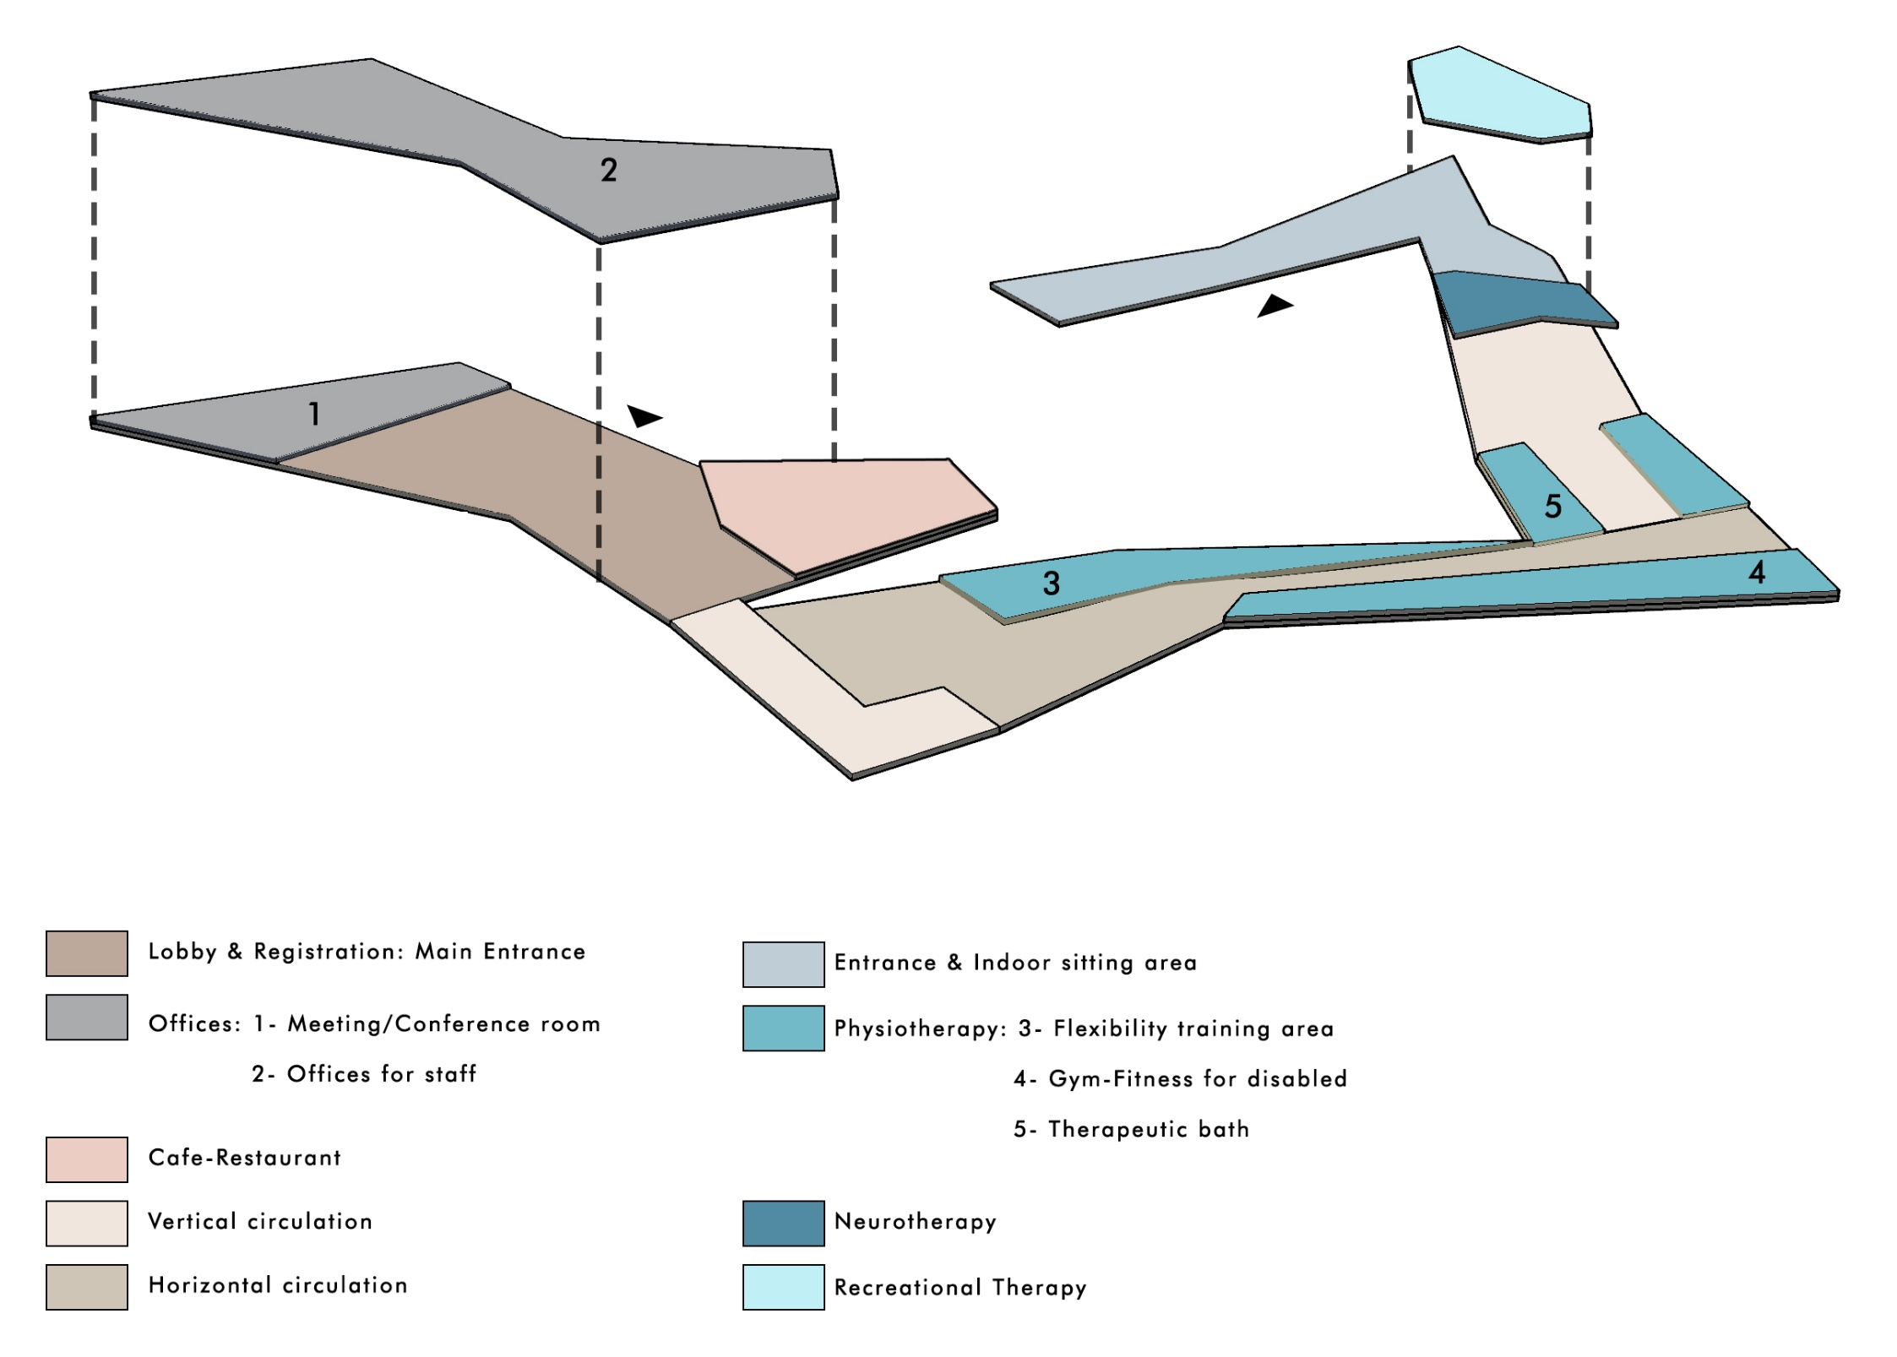
CONCEPTUAL FLOOR PLAN

Slide 10
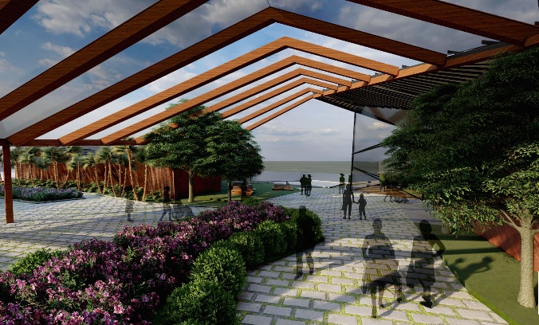
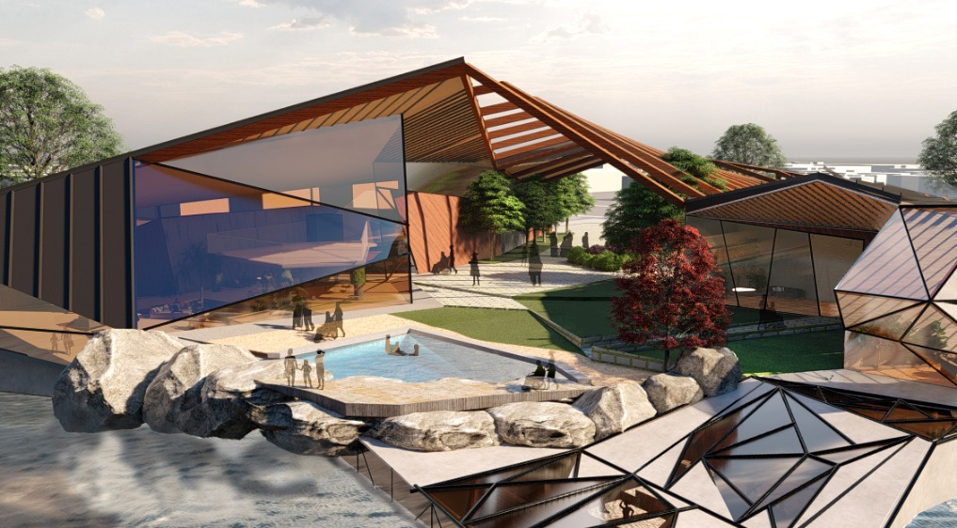
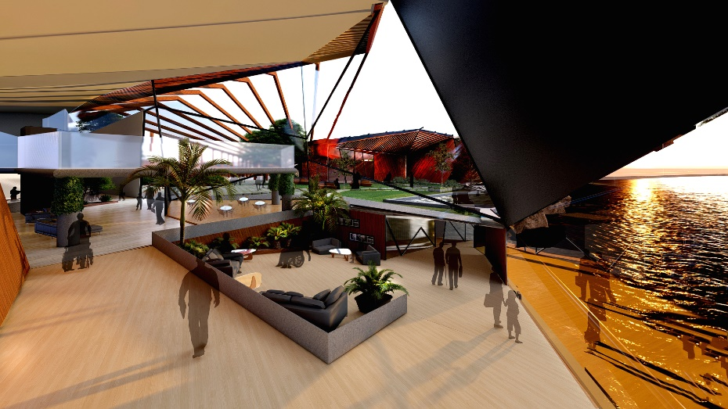
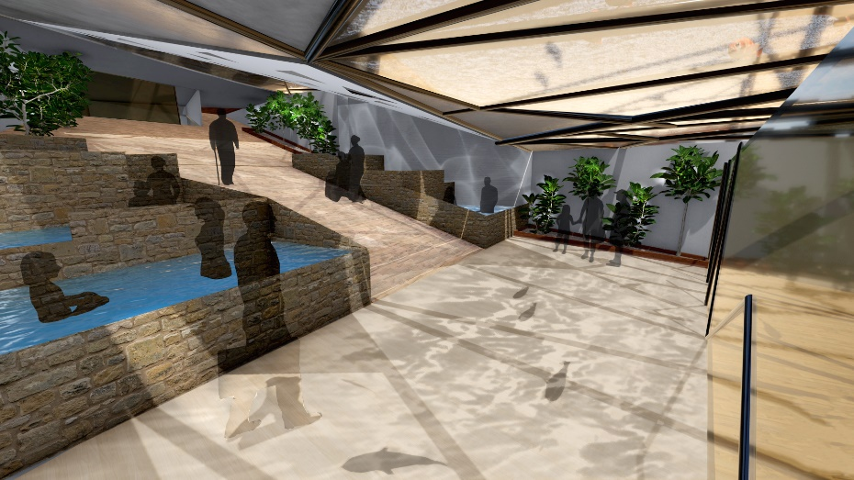
PERSPECTIVES

Slide 13
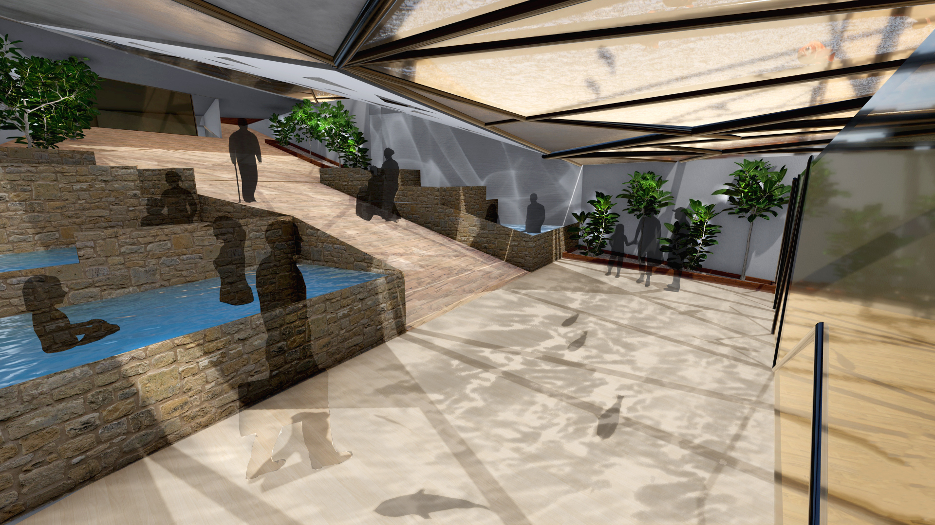

Slide 15
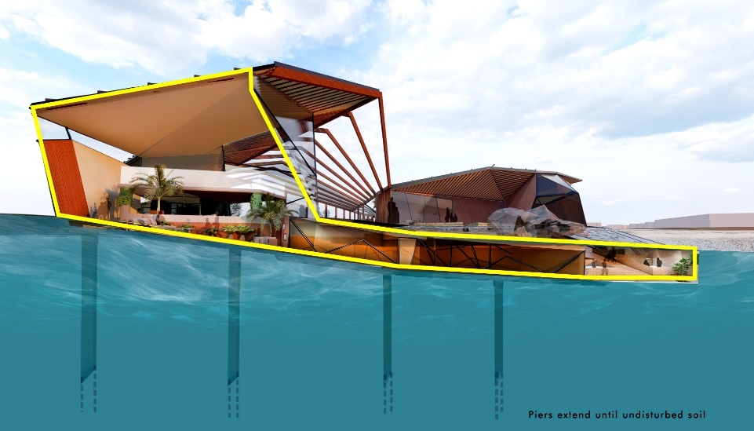
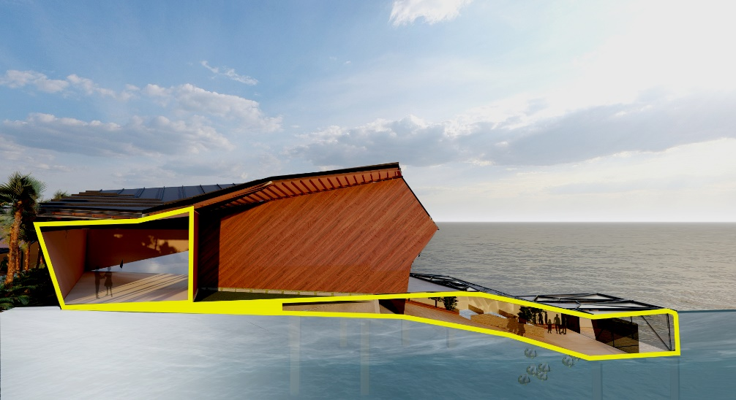
SECTION PERSPECTIVES

Slide 18
DIAGRAMS
WATER TREATMENT
ROOF STRUCTURE
UNDERWATER STRUCTURE
GREENHOUSE STRUCTURE

Slide 19
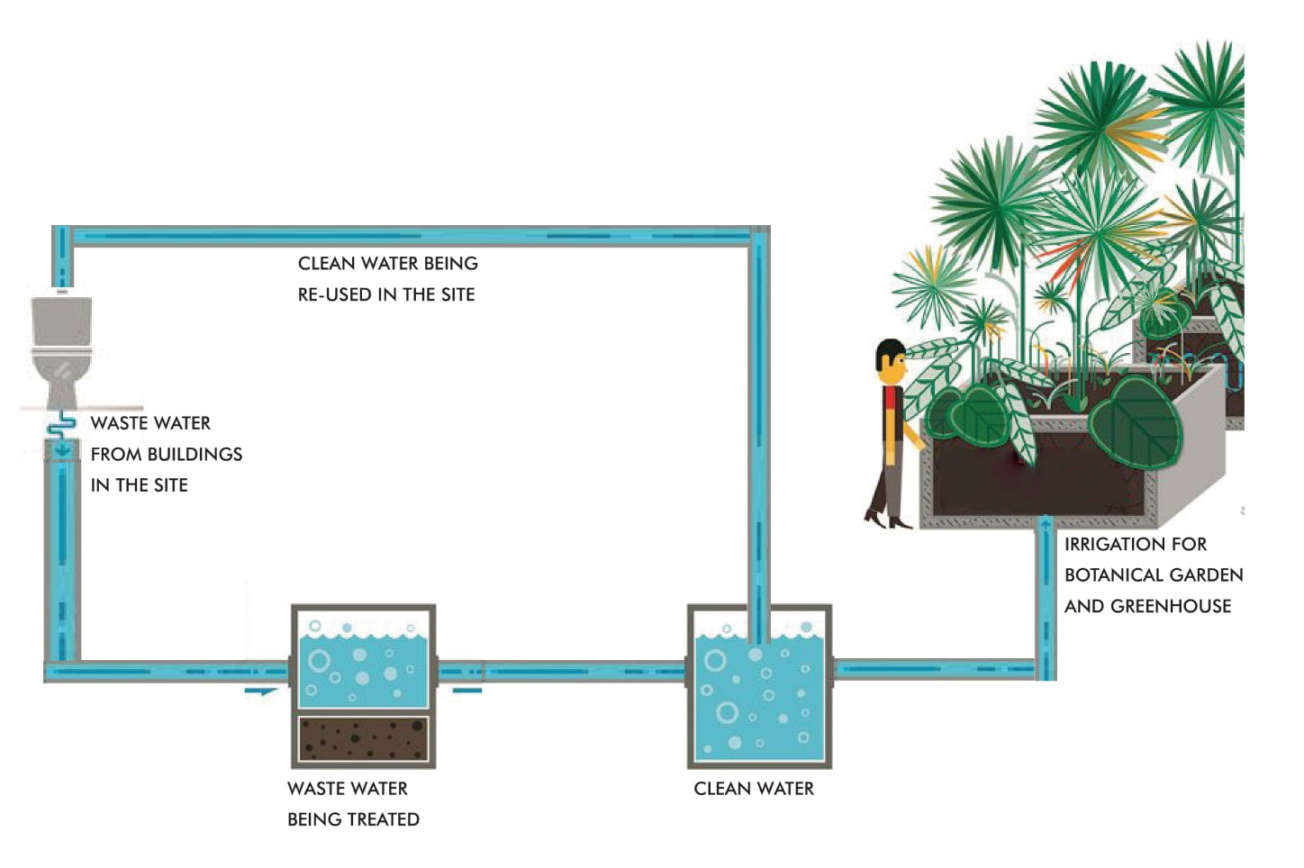
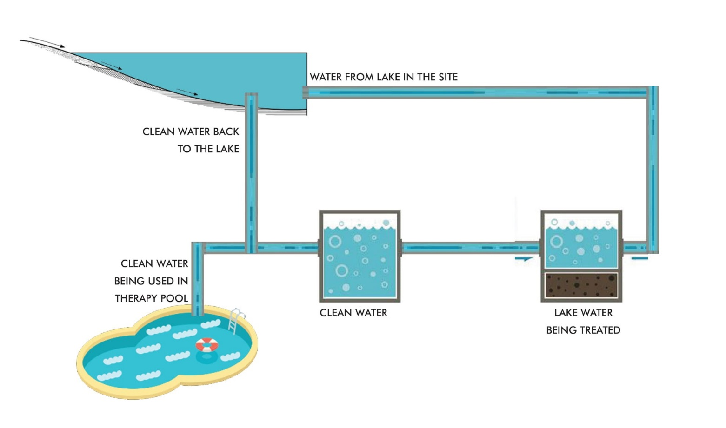
WATER TREATMENT DIAGRAMS

Slide 20
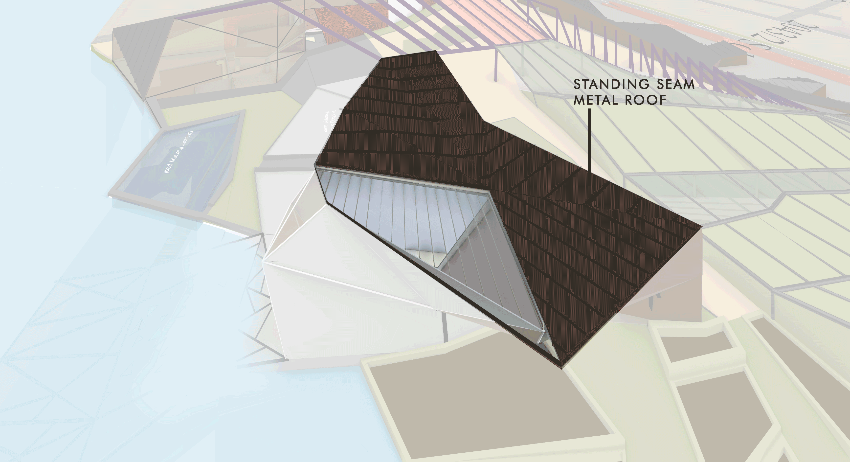
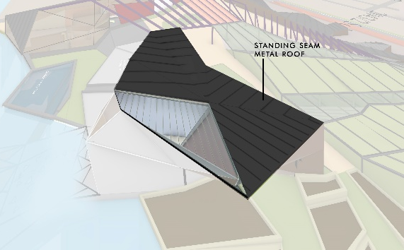
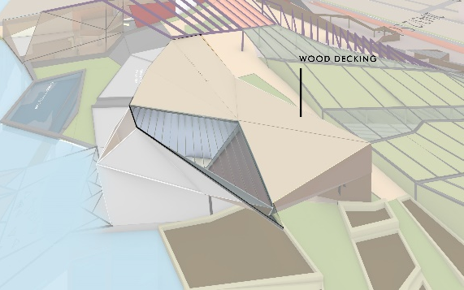
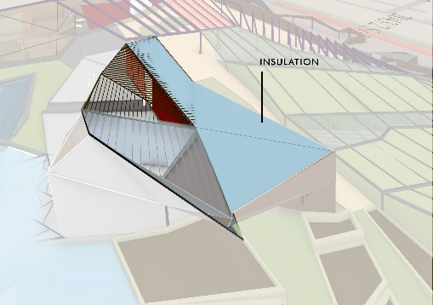
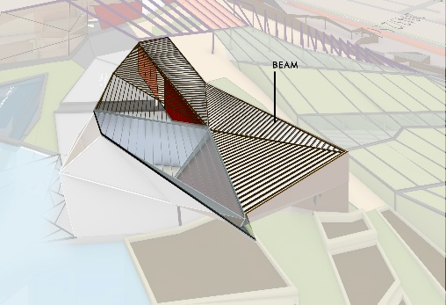
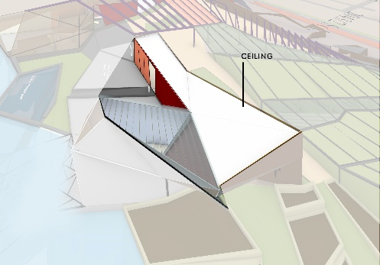
ROOF STRUCTURE DIAGRAM

Slide 23
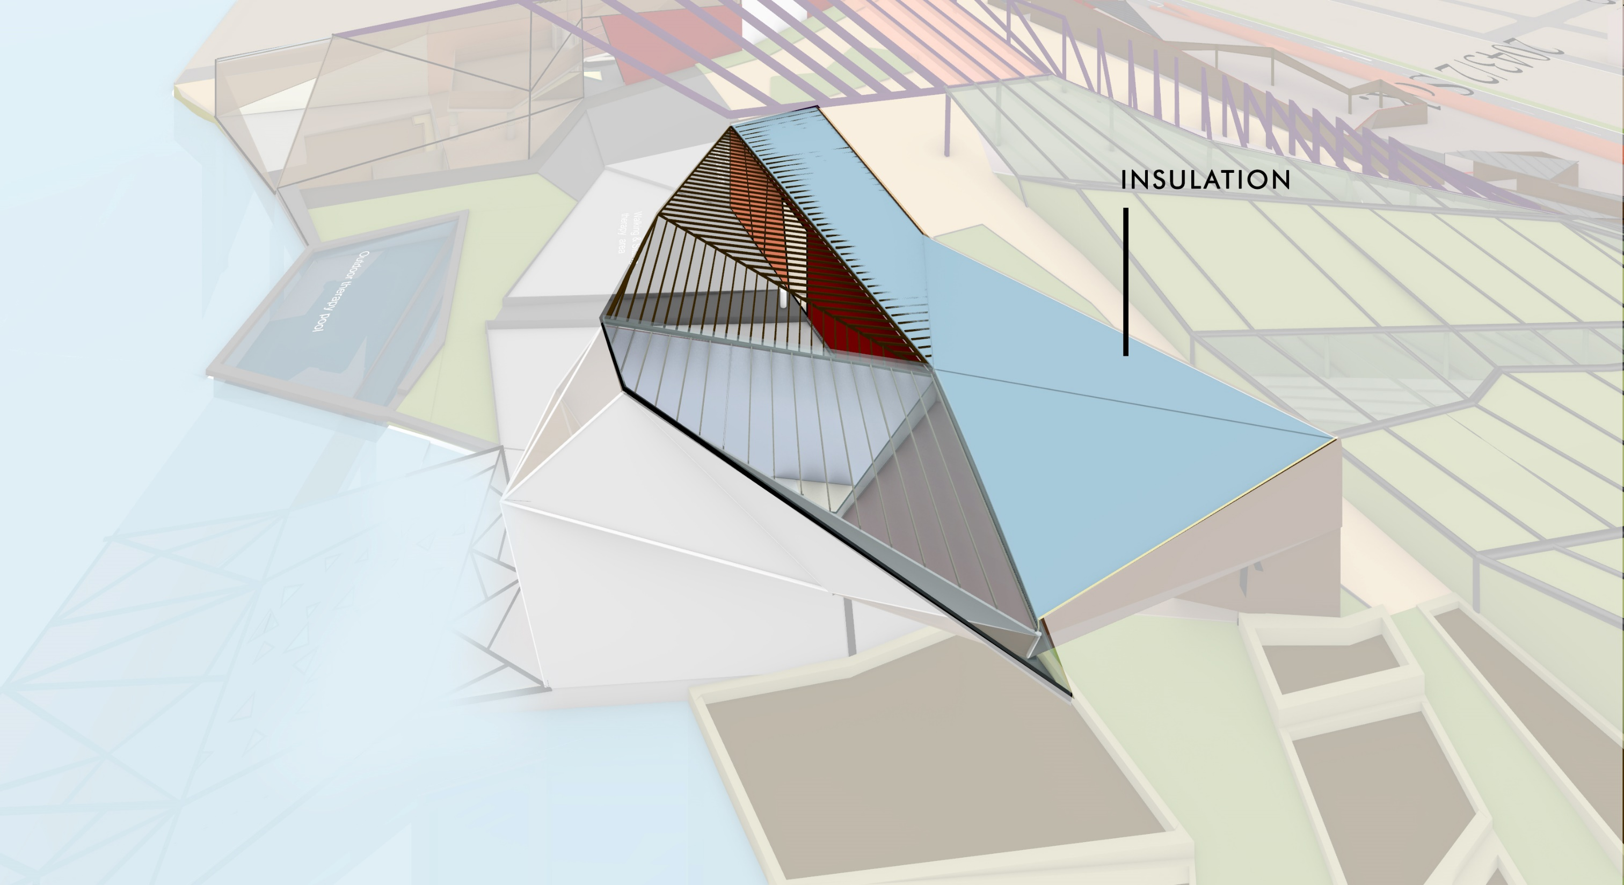

Slide 25
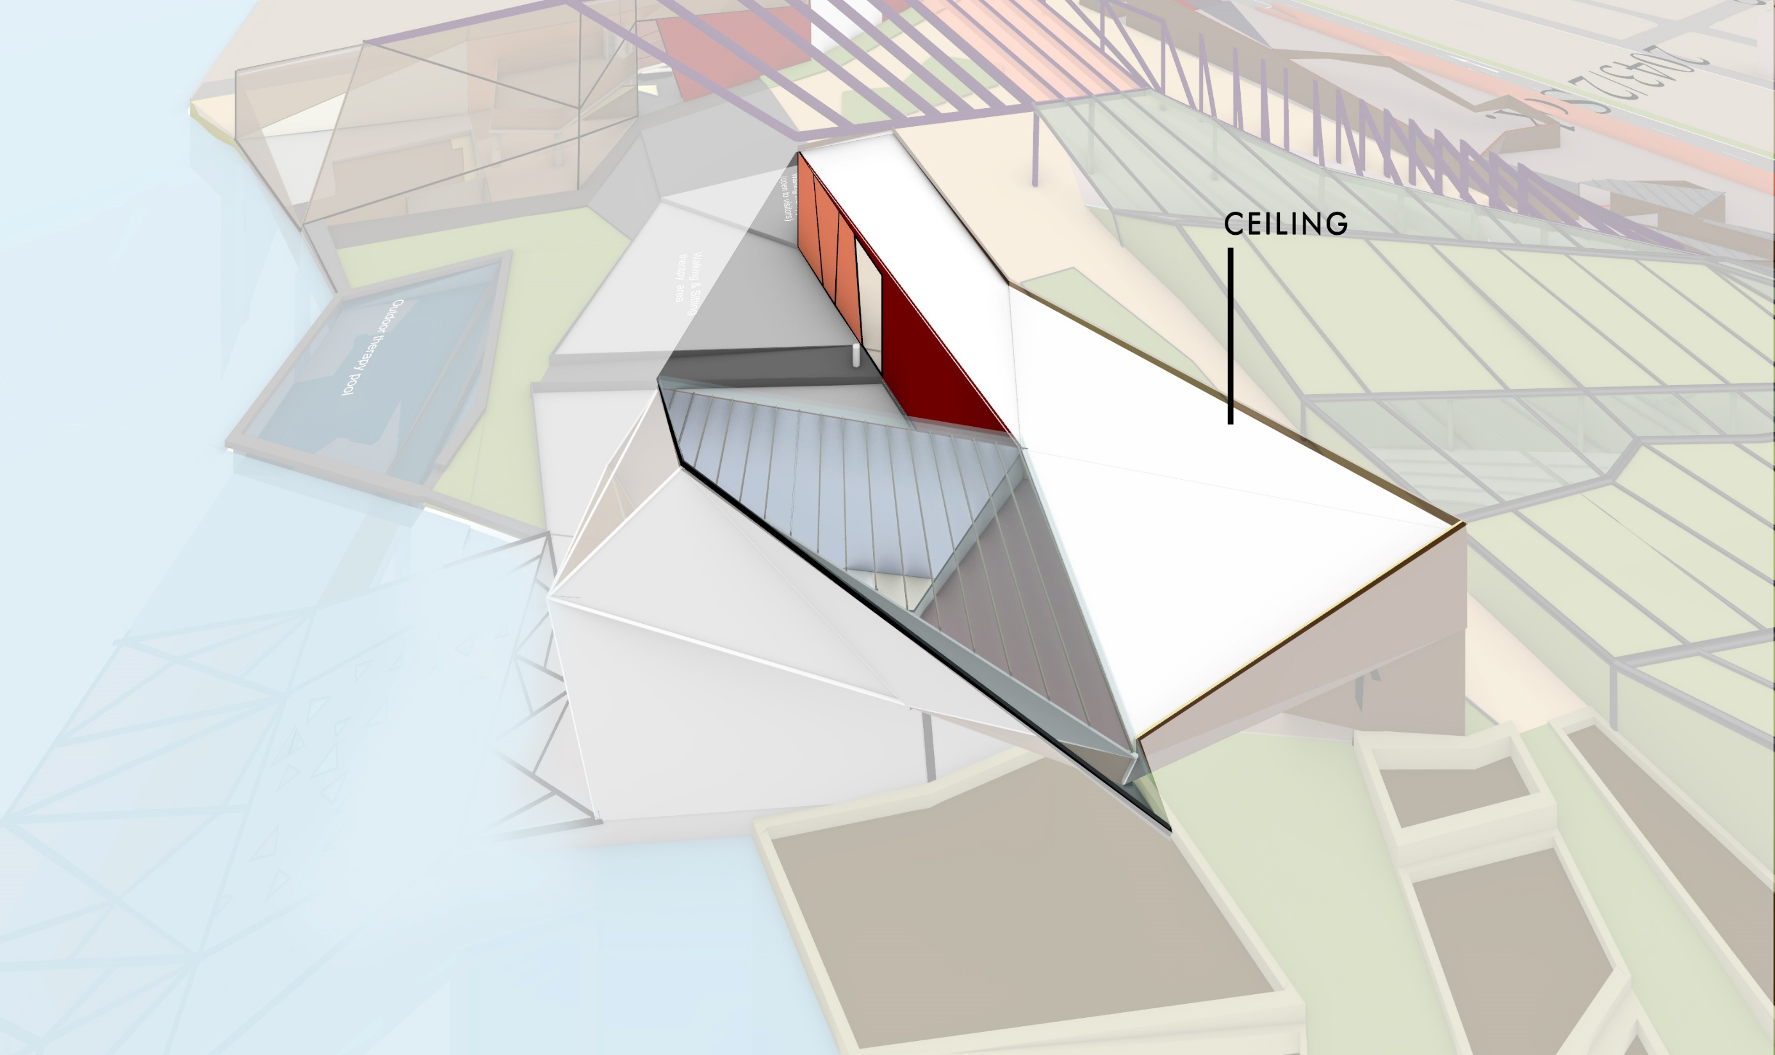

Slide 26
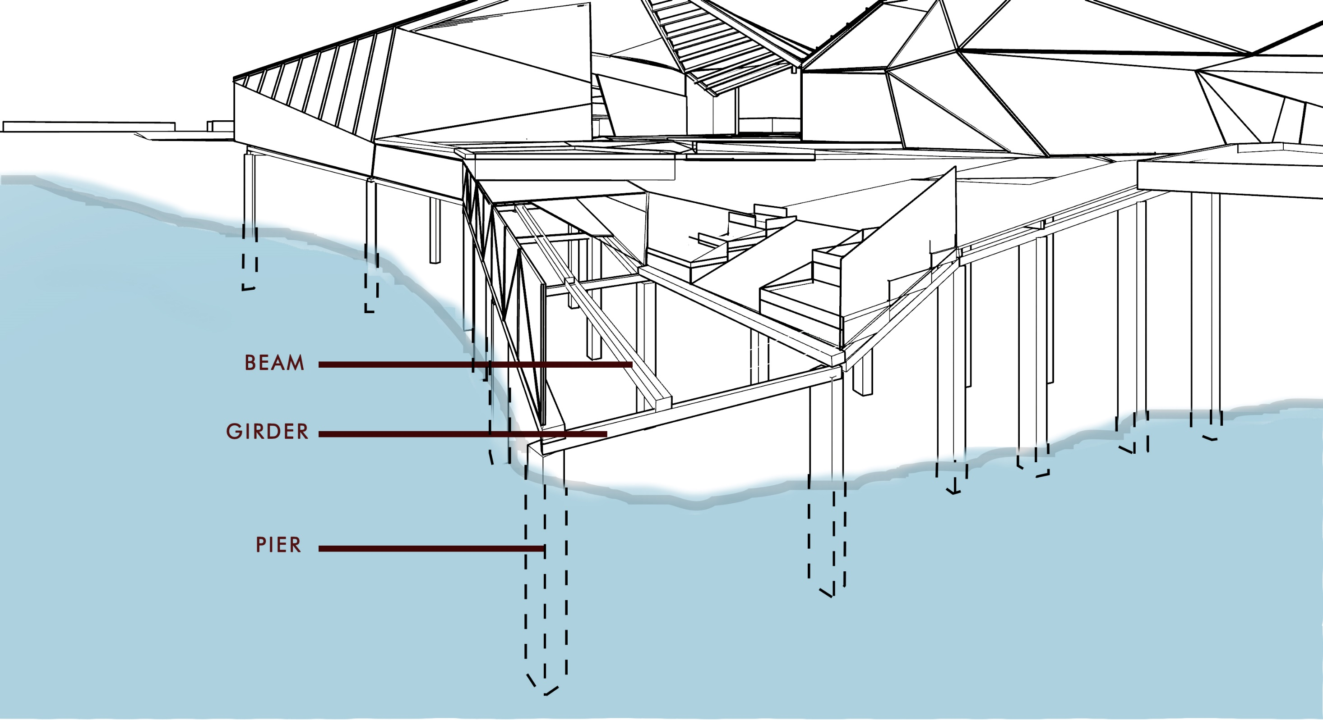
UNDERWATER STRUCTURE DIAGRAM

Slide 27
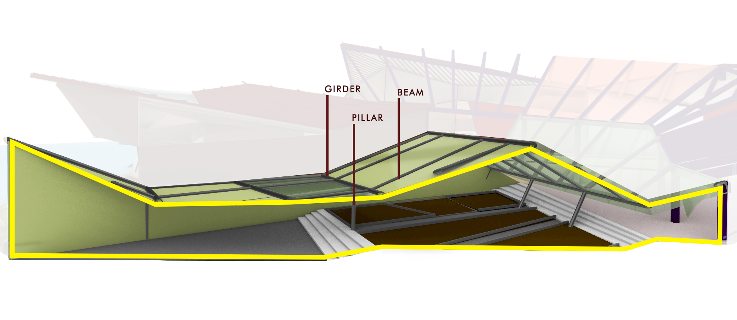
GREENHOUSE STRUCTURE DIAGRAM

Slide 28
PROJECT VIDEO

Slide 29
INTRODUCTION TO THE SITE
CONCEPTUAL PLANS
DIAGRAMS
PERSPECTIVES
SECTION PERSPECTIVES
PROJECT VIDEO
THANK YOU!

